Slide 1

Theology
Of
Vocation

Slide 2
The Theology of Vocation
October 9: Design and Dignity of Work
October 16: Working as Unto the Lord
October 23: Operating within God’s Calling
October 30: Working in a Fallen World
November 6: A Society that Doesn’t Work

Slide 3
Calling
Vocation

Slide 4
The Theology of Vocation
Called By God
Hearing God's Call
Confirming the Call
Obeying the Call
Called to Serve

Slide 5

Picture of a hand answering a telephone

Slide 6
Romans 8:30
“And those he predestined, he also called; those he called, he also justified; those he justified, he also glorified.”

Slide 7
Ephesians 4:1
“As a prisoner for the Lord, then, I urge you to live a life worthy of the calling you have received.”

Slide 8
Ephesians 4:1 (KJV)
“I therefore, the prisoner of the Lord, beseech you that ye walk worthy of the vocation wherewith ye are called…”

Slide 9
Every Christian’s
Vocation
Living in unity within the body of Christ
Living in spiritual light, not sinful darkness
Living rightly as a Christian household
Living to honor Christ in the workplace
Living on guard throughout spiritual battle

Slide 10
Ephesians 4:7
“But to each one of us grace has been given as Christ apportioned it.”

Slide 11
1 Corinthians 7:17
“Nevertheless, each one should retain the place in life that the Lord assigned to him and to which God has called him. This is the rule I lay down in all the churches.”

Slide 12
Jeremiah 29:11
“‘For I know the plans I have for you,’ declares the LORD, ‘plans to prosper you and not to harm you, plans to give you hope and a future.’”

Slide 13
The Theology of Vocation
Called By God
Hearing God's Call
Confirming the Call
Obeying the Call
Called to Serve

Slide 14
“Suppose for a moment that the Lord Jesus Christ were to grant you the answer to one question—any question you wanted to ask. What would that question be? My guess is that it would probably be related in some way to knowing God’s will for your life.”
- Paul Little

Slide 15
Romans 12:1-2
“Therefore, I urge you, brothers, in view of God's mercy, to offer your bodies as living sacrifices, holy and pleasing to God - this is your spiritual act of worship. Do not conform any longer to the pattern of this world, but be transformed by the renewing of your mind. Then you will be able to test and approve what God's will is - his good, pleasing and perfect will.”

Slide 16
Romans 12:1-2
Be sure you are saved
Offer all of yourself to God
Stop conforming to the world’s pattern
Then test and approve God’s will

Slide 17
Hearing from God
He speaks through His Word
Be obedient to what God has shown you
When you ask God, take time to listen

Slide 18
The Theology of Vocation
Called By God
Hearing God's Call
Confirming the Call
Obeying the Call
Called to Serve

Slide 19
Confirming the Call
Counsel with mature Christians
Take the initial steps
Let God warn you if you are departing from His will

Slide 20
Proverbs 11:14
“For lack of guidance a nation falls, but many advisers make victory sure.”

Slide 21
Confirming the Call
Counsel with mature Christians
Take the initial steps
Let God warn you if you are departing from His will

Slide 22
Colossians 3:15
“Let the peace of Christ rule in your hearts, since as members of one body you were called to peace. And be thankful.”

Slide 23
The Theology of Vocation
Called By God
Hearing God's Call
Confirming the Call
Obeying the Call
Called to Serve

Slide 24
Acts 16:6-12
They were already serving
They were spiritually sensitive
They tested to see if it was from God
They set out to obey at once

Slide 25
2 Timothy 4:5
“But you, keep your head in all situations, endure hardship, do the work of an evangelist, discharge all the duties of your ministry.”

Slide 26
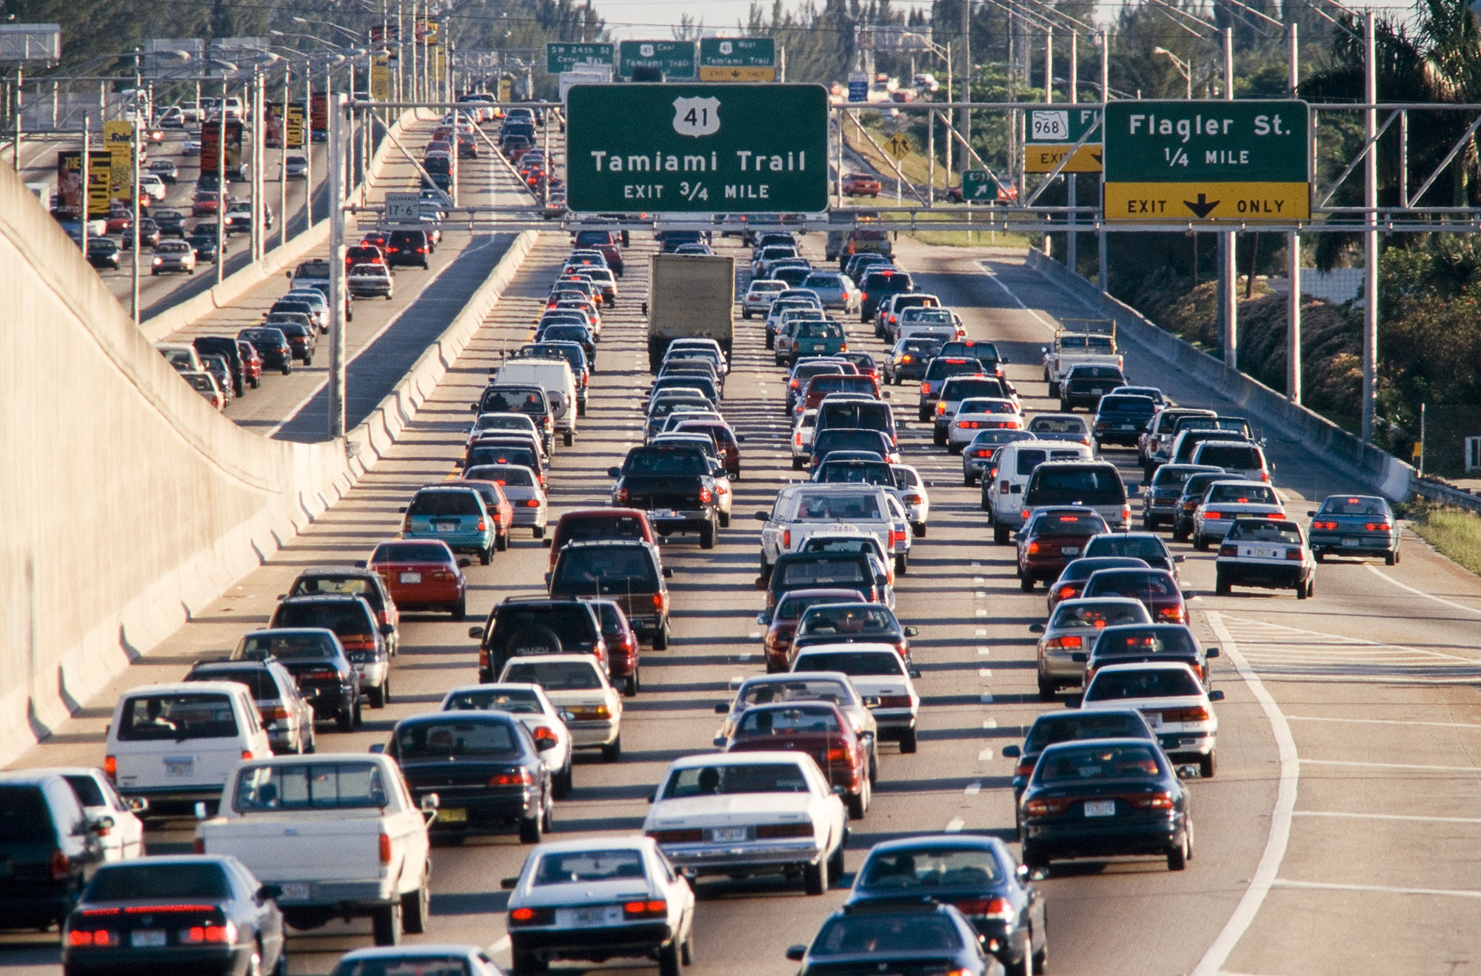
Picture of a car (very wide freeway, lots of traffic)

Slide 27

Picture of hands on a steering wheel and the car is driving

Slide 28
The Theology of Vocation
Called By God
Hearing God's Call
Confirming the Call
Obeying the Call
Called to Serve

Slide 29
Mark 10:45
“For even the Son of Man did not come to be served, but to serve, and to give his life as a ransom for many.”

Slide 30
2 Timothy 4:6-8
“For I am already being poured out like a drink offering, and the time has come for my departure. I have fought the good fight, I have finished the race, I have kept the faith…

Slide 31
2 Timothy 4:6-8
“Now there is in store for me the crown of righteousness, which the Lord, the righteous Judge, will award to me on that day—and not only to me, but also to all who have longed for his appearing.”

Slide 32
“Remember that something can be a vocation or calling only if some other party calls you to do it, and you do it for their sake rather than for your own. Our daily work can be a calling only if it is reconceived as God’s assignment to serve others. And that is exactly how the Bible teaches us to view work.”
-Timothy Keller

Slide 33
“Christians should be aware of this revolutionary understanding of the purpose of their work in the world. We are not to choose jobs and conduct our work to fulfill ourselves and accrue power, for being called by God to do something is empowering enough. We are to see work as a way of service to God and our neighbor, and so we should both choose and conduct our work in accordance with that purpose…

Slide 34
The question regarding our choice of work is no longer, ‘what will make me the most money and give me the most status?’ The question must now be, ‘how, with my existing abilities and opportunities, can I be of greatest service to other people, knowing what I do of God’s will and of human need’”
-Timothy Keller

Slide 35
The Theology of Vocation
October 9: Design and Dignity of Work
October 16: Working as Unto the Lord
October 23: Operating within God’s Calling
October 30: Working in a Fallen World
November 6: A Society that Doesn’t Work

Slide 36
Theology
Of
Vocation

