Slide 1



Slide 2
Theology
Of
Vocation

Slide 3
Calling
Vocation

Slide 4
The Theology of Vocation
October 9: Design and Dignity of Work
October 16: Working as Unto the Lord
October 23: Operating within God’s Calling
October 30: Working in a Fallen World
November 6: A Society that Doesn’t Work

Slide 5
The Theology of Vocation
Frustration With Work
Unfulfilled With Work
Misplaced Priorities At Work
Conflicts At Work

Slide 6
Genesis 2:15
“The LORD God took the man and put him in the Garden of Eden to work it and take care of it.”

Slide 7
Genesis 2:19
“Now the LORD God had formed out of the ground all the beasts of the field and all the birds of the air. He brought them to the man to see what he would name them; and whatever the man called each living creature, that was its name.”

Slide 8
In the Family
Greatly increase pains in childbearing (Gen. 3:16)
Roles in marriage become more intentional and more challenging (Gen. 3:16)

Slide 9
In the Workplace
Cursed is the ground because of you (Gen. 3:17)
It will produce thorns and thistles (Gen. 3:18)
By the sweat of your brow you will eat (Gen. 3:19)
Until you return to the ground (Gen. 3:19)

Slide 10

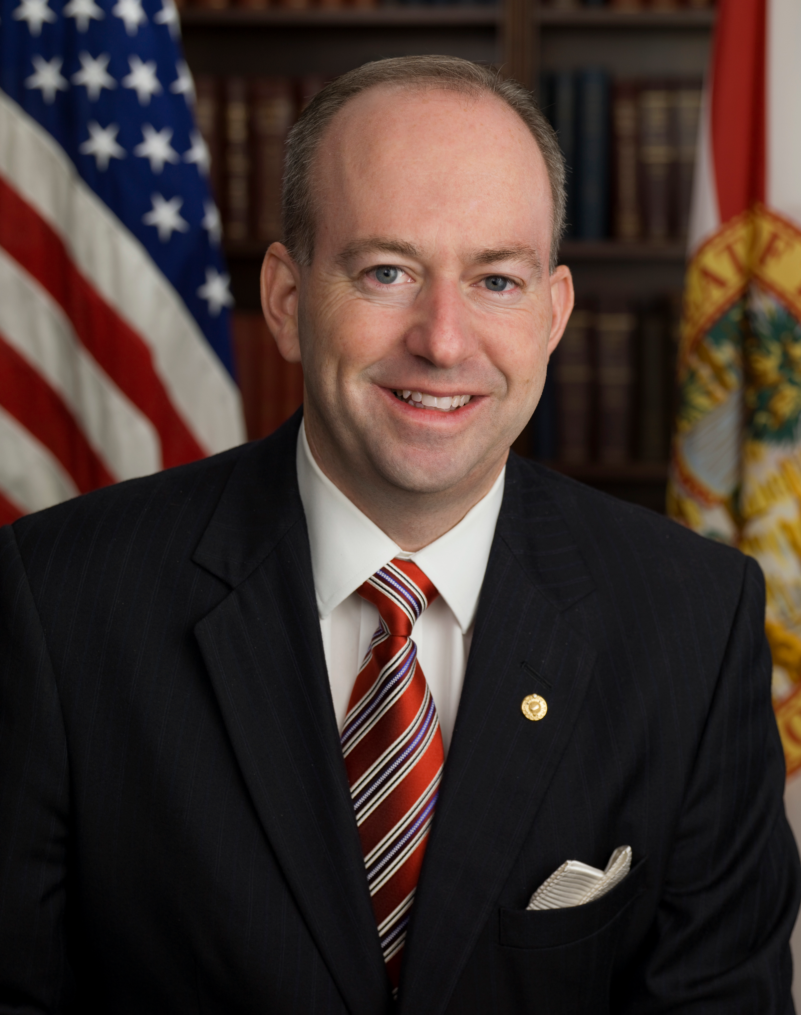
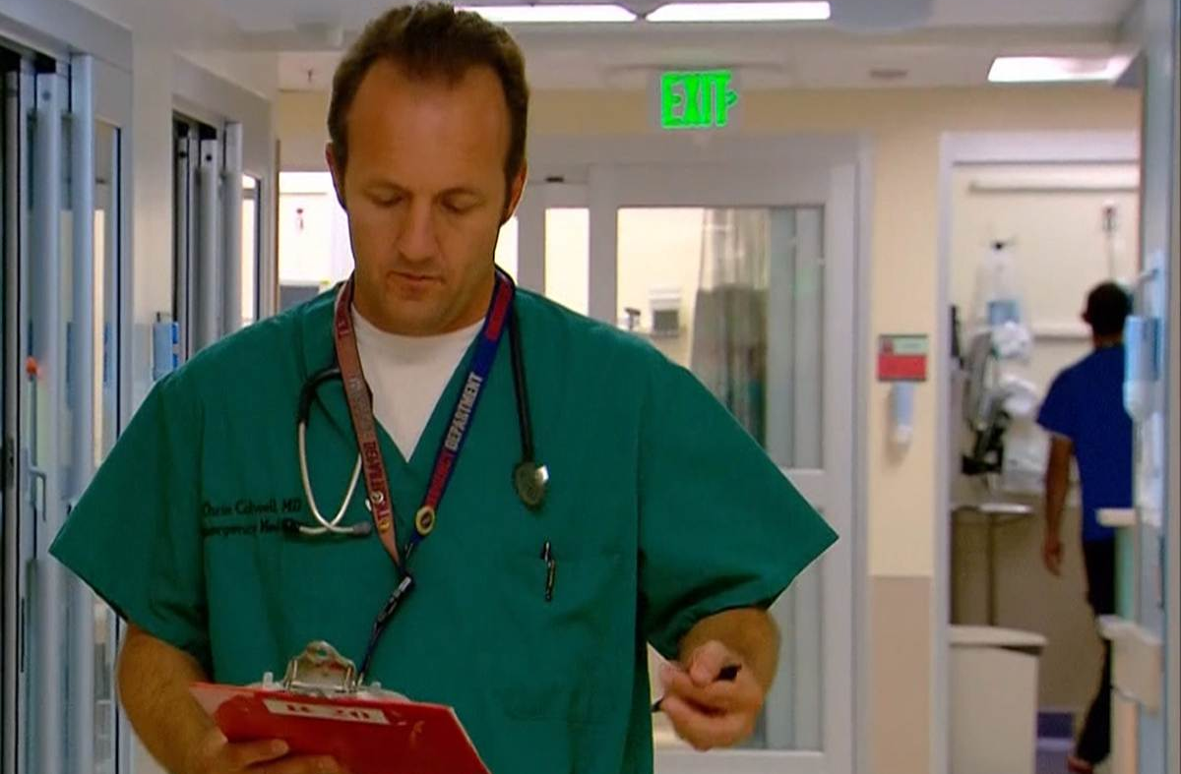

Picture of a teacher, picture of a legislature,
Picture of a restaurantoor,
Picture of an ER doctor

Slide 11
In the Workplace
Cursed is the ground because of you (Gen. 3:17)
It will produce thorns and thistles (Gen. 3:18)
By the sweat of your brow you will eat (Gen. 3:19)
Until you return to the ground (Gen. 3:19)

Slide 12
The Theology of Vocation
Frustration With Work
Unfulfilled With Work
Misplaced Priorities At Work
Conflicts At Work

Slide 13
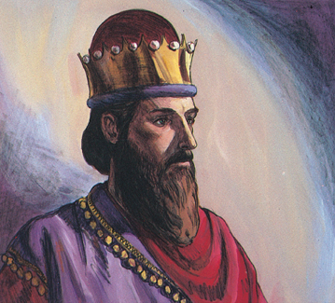

Slide 14
Ecclesiastes 2:4-5
“I undertook great projects: I built houses for myself and planted vineyards. I made gardens and parks and planted all kinds of fruit trees in them.”

Slide 15
Ecclesiastes 2:11
“Yet when I surveyed all that my hands had done and what I had toiled to achieve, everything was meaningless, a chasing after the wind; nothing was gained under the sun.”

Slide 16
Work Without God’s Calling
Ecclesiastes 2:17-23
Work is grievous (v. 17)
Work is not eternal (v. 18)
Work is easily undermined (v. 19)
Work is meaningless (vv. 19-23)

Slide 17
The Theology of Vocation
Frustration With Work
Unfulfilled With Work
Misplaced Priorities At Work
Conflicts At Work

Slide 18
Misplaced Priorities at Work
Idolatry
Selfishness
Laziness

Slide 19
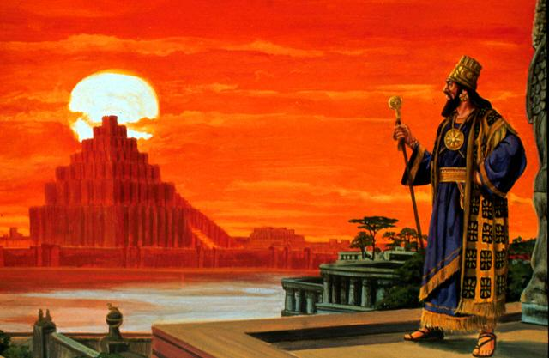
Idolatry
Picture of Nebucanezzar out on the roof admiring his city

Slide 20
Idolatry
“Twelve months later, as the king was walking on the roof of the royal palace of Babylon, he said, ‘Is not this the great Babylon I have built as the royal residence, by my mighty power and for the glory of my majesty?’”
(Daniel 4:29-30)

Slide 21
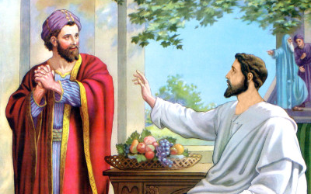
Selfishness
Picture of Zacchaeus holding his money bags and offering to give back half of it because he knows he’s been a cheat

Slide 22
Selfishness
“But Zacchaeus stood up and said to the Lord, ‘Look, Lord! Here and now I give half of my possessions to the poor, and if I have cheated anybody out of anything, I will pay back four times the amount.’ Jesus said to him, ‘Today salvation has come to this house, because this man, too, is a son of Abraham. For the Son of Man came to seek and to save what was lost.’”

Slide 23

Laziness
Picture of someone being lazy

Slide 24
Laziness
“Lazy hands make a man poor, but diligent hands bring wealth. He who gathers crops in summer is a wise son, but he who sleeps during harvest is a disgraceful son.”
(Proverbs 10:4-5)

Slide 25
The Theology of Vocation
Frustration With Work
Unfulfilled With Work
Misplaced Priorities At Work
Conflicts At Work

Slide 26
Luke 12:42-46
“The Lord answered, ‘Who then is the faithful and wise manager, whom the master puts in charge of his servants to give them their food allowance at the proper time? It will be good for that servant whom the master finds doing so when he returns…

Slide 27
Luke 12:42-46
“‘I tell you the truth, he will put him in charge of all his possessions. But suppose the servant says to himself, “My master is taking a long time in coming,” and he then begins to beat the menservants and maidservants and to eat and drink and get drunk…

Slide 28
Luke 12:42-46
“‘The master of that servant will come on a day when he does not expect him and at an hour he is not aware of. He will cut him to pieces and assign him a place with the unbelievers.’”

Slide 29
Colossians 4:1
“Masters, provide your slaves with what is right and fair, because you know that you also have a Master in heaven.”

Slide 30
Ephesians 6:9
“And masters, treat your slaves in the same way. Do not threaten them, since you know that he who is both their Master and yours is in heaven, and there is no favoritism with him.”

Slide 31
James 5:4
“Look! The wages you failed to pay the workmen who mowed your fields are crying out against you. The cries of the harvesters have reached the ears of the Lord Almighty.”

Slide 32
Ephesians 6:5
“Slaves, obey your earthly masters with respect and fear, and with sincerity of heart, just as you would obey Christ.”

Slide 33
Colossians 3:23-24
“Whatever you do, work at it with all your heart, as working for the Lord, not for men, since you know that you will receive an inheritance from the Lord as a reward. It is the Lord Christ you are serving.”

Slide 34
The Theology of Vocation
October 9: Design and Dignity of Work
October 16: Working as Unto the Lord
October 23: Operating within God’s Calling
October 30: Working in a Fallen World
November 6: A Society that Doesn’t Work

Slide 35
Theology
Of
Vocation

