Slide 1

Theology
Of
Vocation

Slide 2
The Theology of Vocation
October 9: Design and Dignity of Work
October 16: Working as Unto the Lord
October 23: Operating within God’s Calling
October 30: Working in a Fallen World
November 6: A Society that Doesn’t Work

Slide 3
The Theology of Vocation
The Formation of a Biblical Work Ethic
A History of Work In Western Society
The Decaying Work Ethic In American Culture
The Challenge For This Christian Generation

Slide 4
Exodus 20:1-17
You shall have no other gods before Me (v. 3)
You shall not make for yourself an idol (v. 4)
Six days you shall labor and do all your work (v. 8)

Slide 5
Exodus 20:1-17
On the seventh day you are not to do any work (v. 10)
Honor your father and your mother (v. 12)
You shall not steal (v. 15)
You shall not give false testimony
(v. 16)
You shall not covet (v. 17)

Slide 6
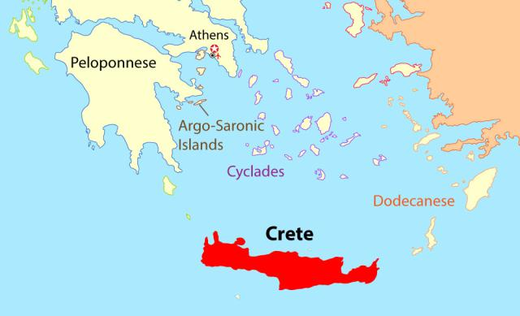
Map of Crete

Slide 7
Titus 1:12
“Even one of their own prophets has said, ‘Cretans are always liars, evil brutes, lazy gluttons.’”

Slide 8
Titus 2:2-3
“Teach the older men to be temperate, worthy of respect, self-controlled, and sound in faith, in love and in endurance. Likewise, teach the older women to be reverent in the way they live, not to be slanderers or addicted to much wine, but to teach what is good.”

Slide 9
Titus 2:5-7
“To be self-controlled and pure, to be busy at home, to be kind, and to be subject to their husbands, so that no one will malign the word of God…

Slide 10
Titus 2:5-7
“Similarly, encourage the young men to be self-controlled. In everything set them an example by doing what is good. In your teaching show integrity, seriousness.”

Slide 11
Titus 2:10
“And not to steal from them, but to show that they can be fully trusted, so that in every way they will make the teaching about God our Savior attractive.”

Slide 12
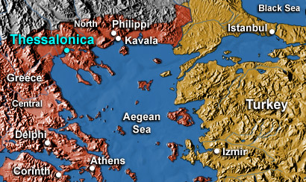
Map of Thessolonica

Slide 13
1 Thessalonians 5:12
“Now we ask you, brothers, to respect those who work hard among you, who are over you in the Lord and who admonish you.”

Slide 14
1 Thessalonians 5:14
“And we urge you, brothers, warn those who are idle, encourage the timid, help the weak, be patient with everyone.”

Slide 15
1 Thessalonians 4:11-12
“Make it your ambition to lead a quiet life, to mind your own business and to work with your hands, just as we told you, so that your daily life may win the respect of outsiders and so that you will not be dependent on anybody.”

Slide 16
2 Thessalonians 3:6-15
Command you to keep away from idol brother
Remember we did not eat anyone’s food without paying for it
We worked night and day in order not to be a burden

Slide 17
2 Thessalonians 3:6-15
If a man will not work, he shall not eat
The idle are commanded in Christ to earn their bread
Do not associate with those who will not obey this instruction

Slide 18
The Theology of Vocation
The Formation of a Biblical Work Ethic
A History of Work In Western Society
The Decaying Work Ethic In American Culture
The Challenge For This Christian Generation

Slide 19
Jews
Greeks
Christians

Slide 20
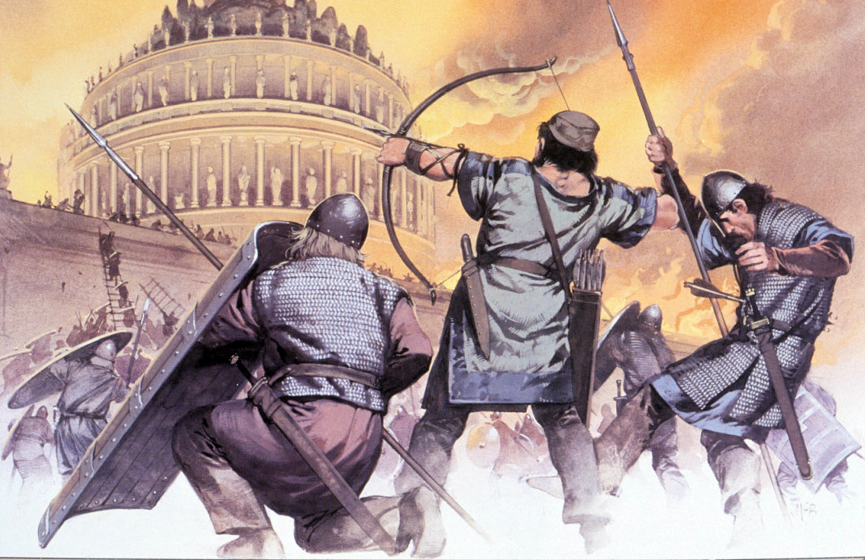
Picture of the fall of the Roman empire (Barbarians burning Rome in 500 AD)

Slide 21
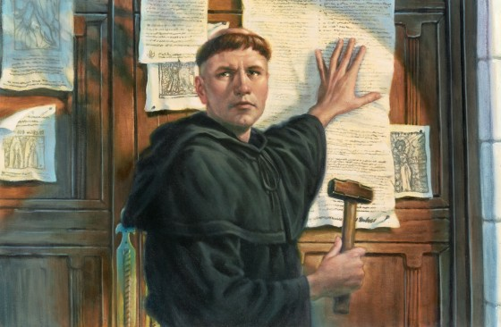
Picture of Luther and the 95 Theses

Slide 22
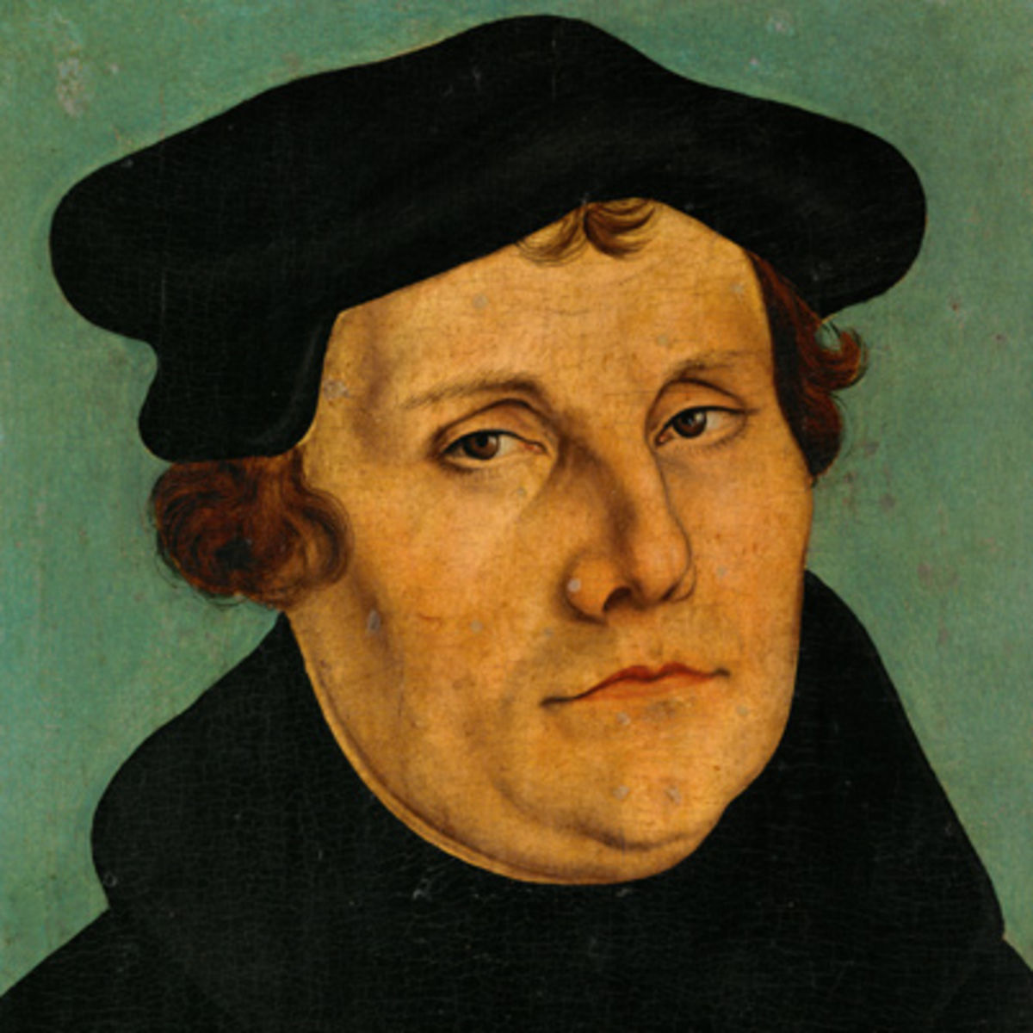
The work of the clergy is “in God’s sight in no way whatever superior to the work of a farmer laboring in the field or of a woman looking after her home.”
-Martin Luther

Slide 23
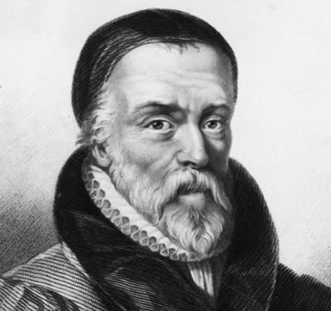
“If we look externally, there is a difference betwixt the washing of dishes and preaching the Word of God; But as touching to please God, in relation to His call, none at all.”
-William
Tyndale

Slide 24
“Such teachings freed people to do what they did best for God’s glory, and a new breed of workers was born. Out of religious conviction these men and women sought excellence and shunned idleness, vanity, and waste as deadly sins.”
-Charles Colson

Slide 25
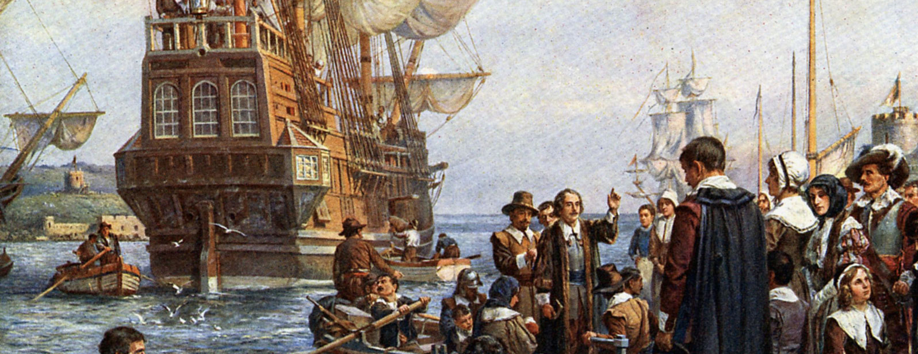
They came “as laborers for their Lord, straighteners of crooked places, engaged in a task filled with hardship, deprivation, and toil.”
-David Rodgers

Slide 26
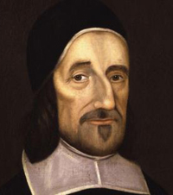
“Choose the employment or calling in which you may be most serviceable to God. Choose not that in which you may be most rich or honorable in this world; but that in which you may do most good, and best escape sinning.”
-Richard Baxter

Slide 27
The Theology of Vocation
The Formation of a Biblical Work Ethic
A History of Work In Western Society
The Decaying Work Ethic In American Culture
The Challenge For This Christian Generation

Slide 28


Slide 29
We need “a practical culture in which man is free from labor, free to begin at last the historic task of constructing truly human relationships.”
-Martin Nicholas

Slide 30


Slide 31
Exodus 20:1-17
You shall have no other gods before Me (v. 3)
You shall not make for yourself an idol (v. 4)
Six days you shall labor and do all your work (v. 8)

Slide 32
Exodus 20:1-17
On the seventh day you are not to do any work (v. 10)
Honor your father and your mother (v. 12)
You shall not steal (v. 15)
You shall not give false testimony
(v. 16)
You shall not covet (v. 17)

Slide 33
The Breakdown of our View of God Leads to a Breakdown of Society

Slide 34
Statistics for 2013
105,862,000 Full time, year round workers
109,631,000 Americans receiving government benefits as welfare

Slide 35
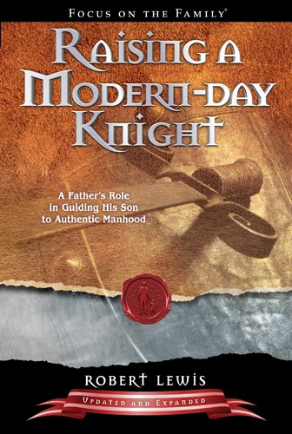

Slide 36
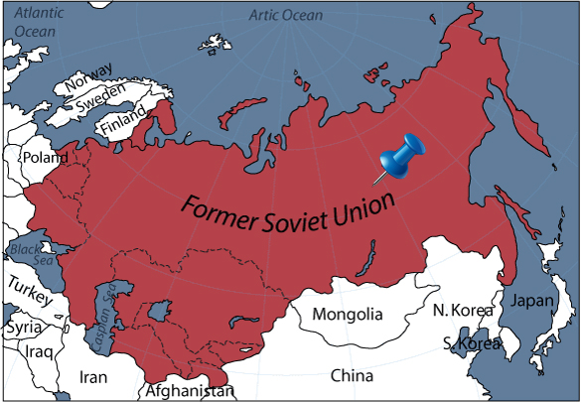
Picture of a map of the soviet union with a pin coming out of the Eastern Soviet Union

Slide 37
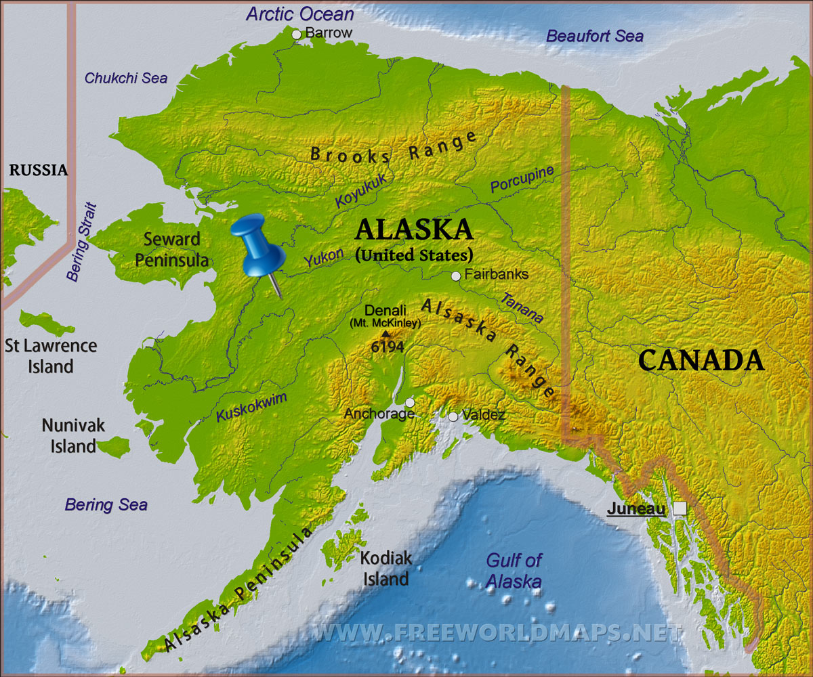

Slide 38
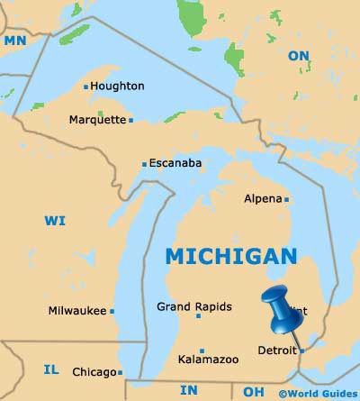

Slide 39
Calling
Vocation

Slide 40
The Theology of Vocation
October 9: Design and Dignity of Work
October 16: Working as Unto the Lord
October 23: Operating within God’s Calling
October 30: Working in a Fallen World
November 6: A Society that Doesn’t Work

Slide 41
Theology
Of
Vocation

