Slide 1
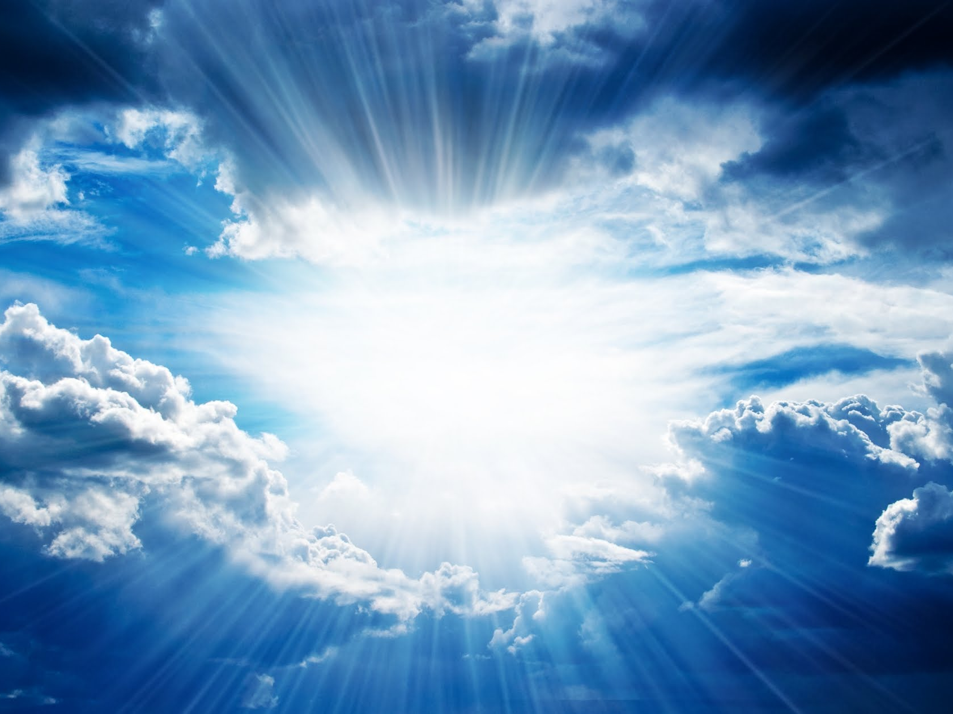
WHEN
HE COMES
The First Letter to the Thessalonians

Slide 2
Paul

Slide 3
Silas
Timothy

Slide 4
The Church
of the
Thessalonians

Slide 5
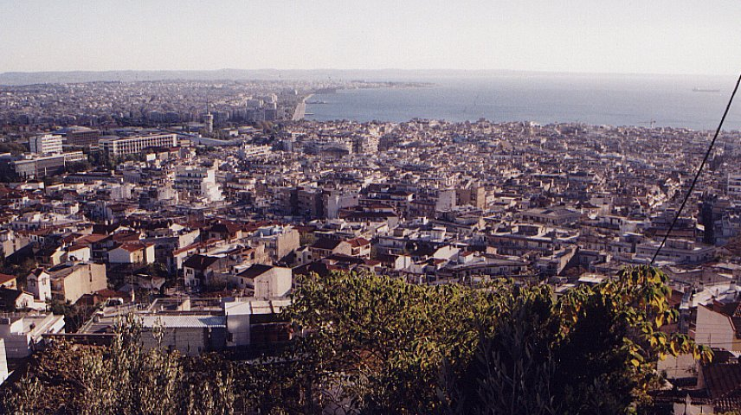
Thessalonica

Slide 6
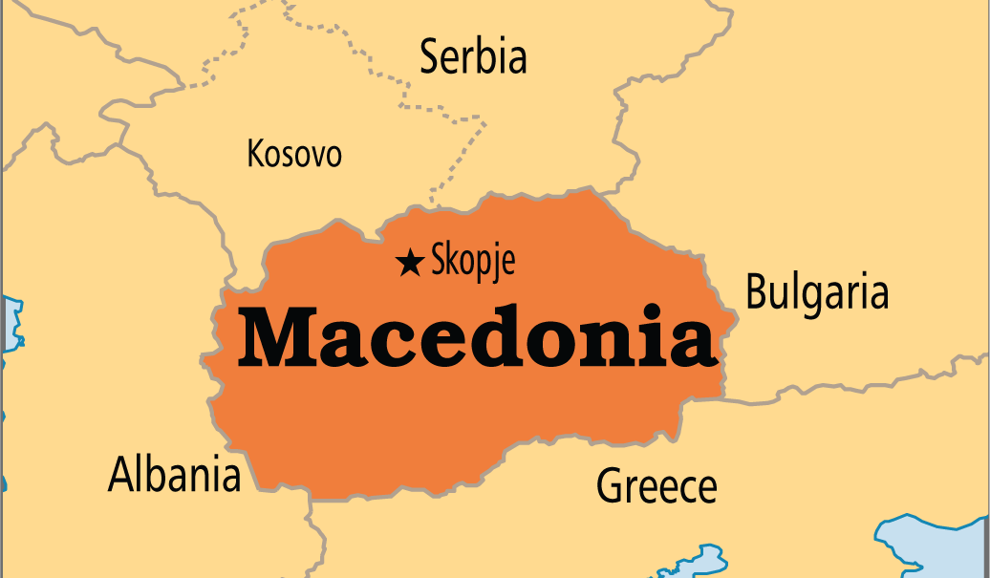
Macedonia

Slide 7
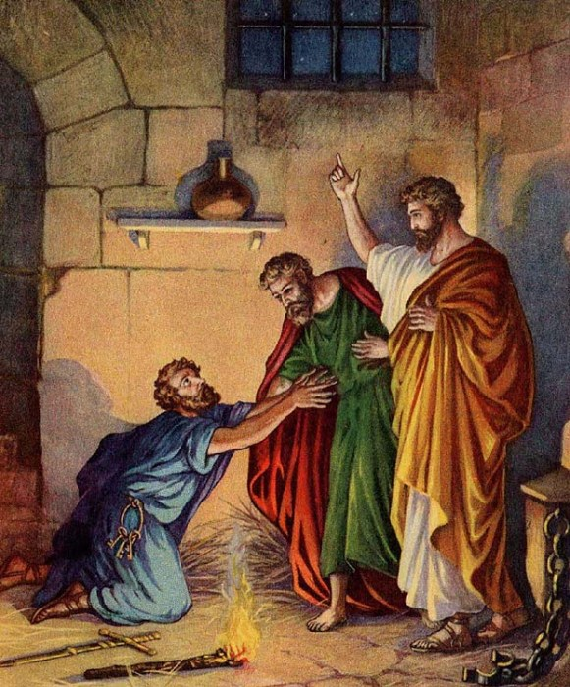

Slide 8
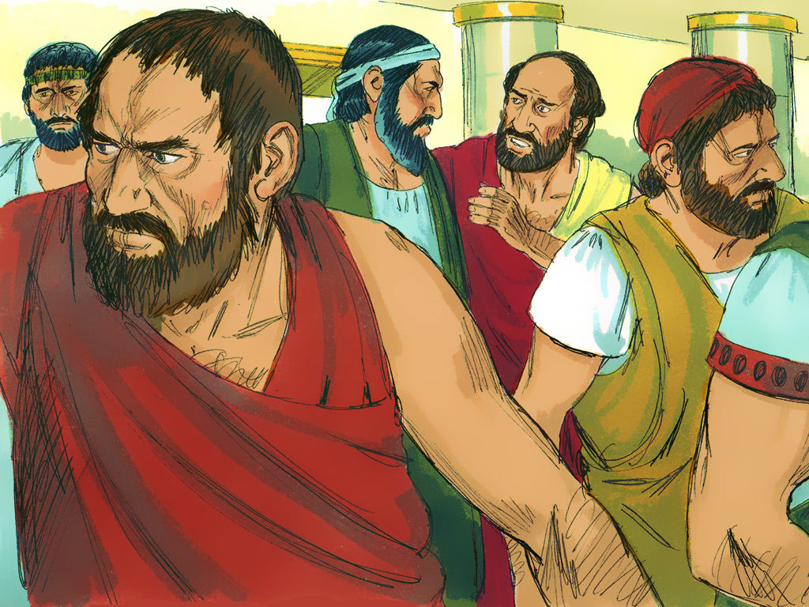
Picture of the riot in Thessalonica (Acts 17)
Blank with
“Riot”

Slide 9
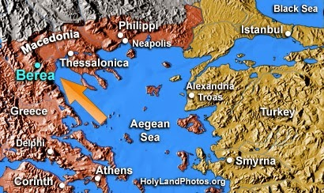
Picture of Berea

Slide 10
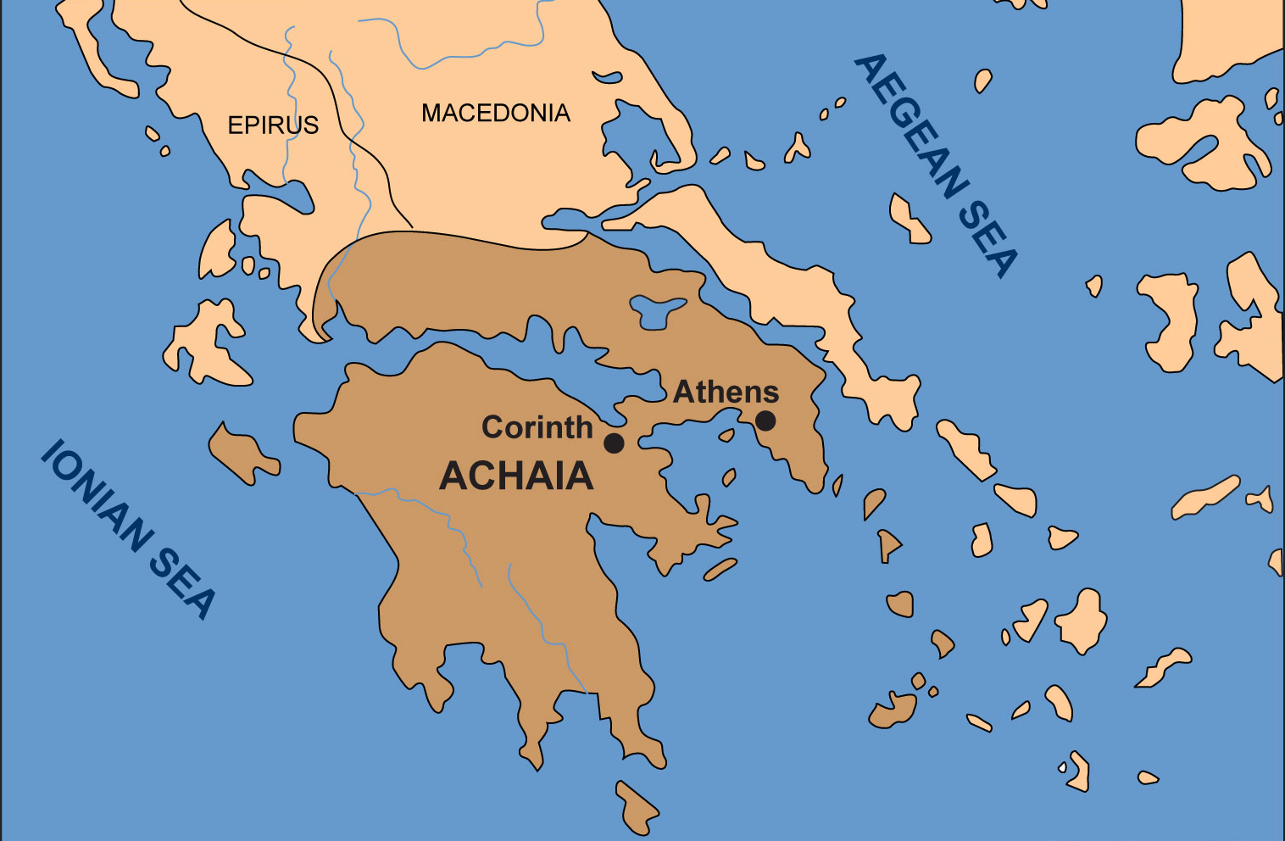
Map showing Athens and Corinth

Slide 11
“When He Comes”
The First Letter to the Thessalonians
November 27 – Chapter One
“Evidence of True Faith”
December 4 – Chapter Two
“Portrait of a Godly Shepherd”
December 11 – Chapter Three
“The Connection Among Christians”
December 18 – Chapter Four
“Sanctification and Resurrection”
December 25 – Chapter Five
“Ready for the Lord’s Return

Slide 12
"When He Comes" Part I
I Thessalonians 1:1-10
Working and Enduring (vv. 2-3)
Spiritual Power and Conviction
(vv. 4-5)
Imitation of the Lord (vv. 6-7)
Broadcasting the Gospel (vv. 8)
Turning From Idols (v. 9)
Awaiting the Lord's Return
(v. 10)

Slide 13
Prays

Slide 14
Work Produced
By Faith

Slide 15
James 2:14-17
“What good is it, my brothers, if a man claims to have faith but has no deeds? Can such faith save him? Suppose a brother or sister is without clothes and daily food. If one of you says to him, "Go, I wish you well; keep warm and well fed," but does nothing about his physical needs, what good is it? In the same way, faith by itself, if it is not accompanied by action, is dead.”

Slide 16
Labor Prompted By Love

Slide 17
1 Thessalonians 2:7
“As apostles of Christ we could have been a burden to you, but we were gentle among you, like a mother caring for her little children.”
1 Thessalonians 2:11
“For you know that we dealt with each of you as a father deals with his own children…”

Slide 18
Endurance
Inspired by Hope

Slide 19
Colossians 1:11
“Being strengthened with all power according to his glorious might so that you may have great endurance and patience, and joyfully.”

Slide 20
Colossians 1:23
“if you continue in your faith, established and firm, not moved from the hope held out in the gospel. This is the gospel that you heard and that has been proclaimed to every creature under heaven, and of which I, Paul, have become a servant.”

Slide 21
The Perseverance
of the Saints

Slide 22
Matthew 10:22
“All men will hate you because of me, but he who stands firm to the end will be saved.”

Slide 23
"When He Comes" Part I
I Thessalonians 1:1-10
Working and Enduring (vv. 2-3)
Spiritual Power and Conviction
(vv. 4-5)
Imitation of the Lord (vv. 6-7)
Broadcasting the Gospel (vv. 8)
Turning From Idols (v. 9)
Awaiting the Lord's Return
(v. 10)

Slide 24
1 John 4:19
“We love because he first loved us.”

Slide 25
Chosen

Slide 26
Salvation Is Not My Doing, It is God’s Doing

Slide 27
Ephesians 1:11-12
“In him we were also chosen, having been predestined according to the plan of him who works out everything in conformity with the purpose of his will…”

Slide 28
Because our Gospel came to you

Slide 29
Not simply with words, but also with power

Slide 30
With the Holy Spirit and with Deep Conviction

Slide 31
"When He Comes" Part I
I Thessalonians 1:1-10
Working and Enduring (vv. 2-3)
Spiritual Power and Conviction
(vv. 4-5)
Imitation of the Lord (vv. 6-7)
Broadcasting the Gospel (vv. 8)
Turning From Idols (v. 9)
Awaiting the Lord's Return
(v. 10)

Slide 32
Imitators of us

Slide 33
1 Corinthians 11:1
“Follow my example, as I follow the example of Christ.”

Slide 34
Imitators of the Lord

Slide 35
1 Peter 2:21
“You should follow in His steps”

Slide 36
Model

Slide 37
Discipleship

Slide 38
Who has discipled you?
Who are you discipling?

Slide 39
"When He Comes" Part I
I Thessalonians 1:1-10
Working and Enduring (vv. 2-3)
Spiritual Power and Conviction
(vv. 4-5)
Imitation of the Lord (vv. 6-7)
Broadcasting the Gospel (vv. 8)
Turning From Idols (v. 9)
Awaiting the Lord's Return
(v. 10)

Slide 40
1 Thessalonians 1:8
“The Lord’s message rang out from you.”

Slide 41
Real Christians are Not Ashamed of the Gospel
“I am not ashamed of the Gospel because it is the power of God for the salvation of everyone who believes.” (Romans 1:16)

Slide 42
Real Christians Love Others Enough to Rescue them from destruction
“Snatch others from the fire and save them.” (Jude 1:23)

Slide 43
"When He Comes" Part I
I Thessalonians 1:1-10
Working and Enduring (vv. 2-3)
Spiritual Power and Conviction
(vv. 4-5)
Imitation of the Lord (vv. 6-7)
Broadcasting the Gospel (vv. 8)
Turning From Idols (v. 9)
Awaiting the Lord's Return
(v. 10)

Slide 44
Idols

Slide 45
1 John 5:21
“Dear children, keep yourselves from idols.”

Slide 46
Serve the Living and True God

Slide 47
"When He Comes" Part I
I Thessalonians 1:1-10
Working and Enduring (vv. 2-3)
Spiritual Power and Conviction
(vv. 4-5)
Imitation of the Lord (vv. 6-7)
Broadcasting the Gospel (vv. 8)
Turning From Idols (v. 9)
Awaiting the Lord's Return
(v. 10)

Slide 48
Wait for His Son from Heaven

Slide 49
1 Thessalonians 1:10
“And to wait for his Son from heaven, whom he raised from the dead--Jesus, who rescues us from the coming wrath.”

Slide 50
1 Thessalonians 2:19
“For what is our hope, our joy, or the crown in which we will glory in the presence of our Lord Jesus when he comes? Is it not you?”

Slide 51
1 Thessalonians 3:13
“May he strengthen your hearts so that you will be blameless and holy in the presence of our God and Father when our Lord Jesus comes with all his holy ones.”

Slide 52
1 Thessalonians 4:17-18
“After that, we who are still alive and are left will be caught up together with them in the clouds to meet the Lord in the air. And so we will be with the Lord forever. Therefore encourage each other with these words.”

Slide 53
1 Thessalonians 5:23
“May God himself, the God of peace, sanctify you through and through. May your whole spirit, soul and body be kept blameless at the coming of our Lord Jesus Christ.”

Slide 54
Six Marks of a
True Christian
Working and Enduring
Spiritual Power and Conviction
Imitation of the Lord
Broadcasting the Gospel
Turning from Idols
Awaiting the Lord’s Return

Slide 55
WHEN
HE COMES
The First Letter to the Thessalonians

