Slide 1

WHEN
HE COMES
The First Letter to the Thessalonians

Slide 2
“When He Comes”
The First Letter to the Thessalonians
November 27 – Chapter One
“Evidence of True Faith”
December 4 – Chapter Two
“Portrait of a Godly Shepherd”
December 11 – Chapter Three
“The Connection Among Christians”
December 18 – Chapter Four
“Sanctification and Resurrection”
December 25 – Chapter Five
“Ready for the Lord’s Return

Slide 3
Evidence of True Faith
Portrait of a Godly Shepherd

Slide 4
"When He Comes" Part II
He Dares to Tell You the Gospel (vv. 1-2)
His Motive Is Not Self-Serving (v. 3)
His Desire Is Only to Please God (vv. 4-6)
He Is Willing to Bear the Burden (vv. 6-9)
His Personal Life Is Pure (vv. 10-12)
His Ministry Bears Mature Fruit (vv. 13-16)
He Longs to Be With His People (vv. 17-20)

Slide 5
1 Thessalonians 2:1
“You know, brothers, that our visit to you was not a failure.”

Slide 6
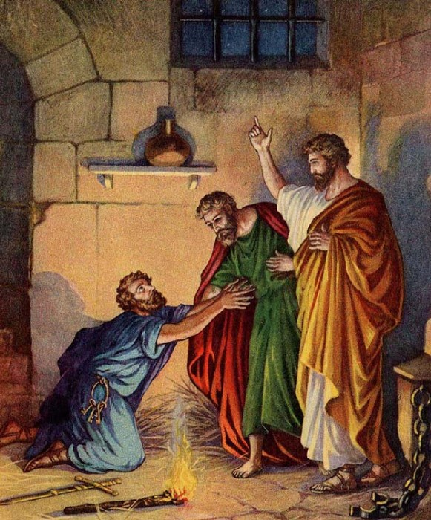

Slide 7
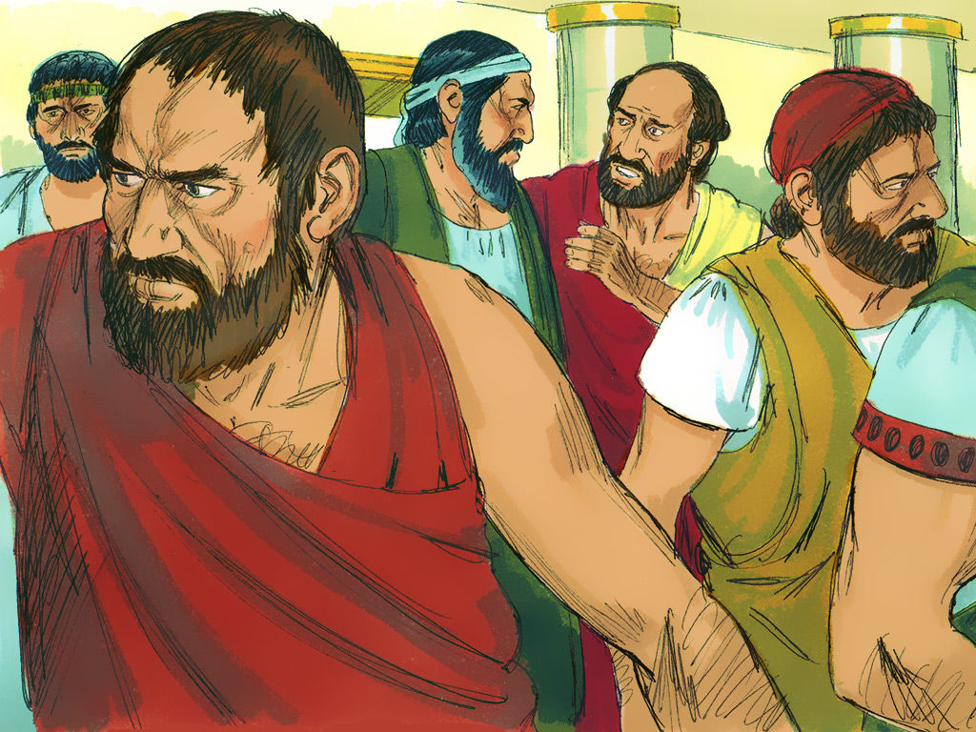

Slide 8
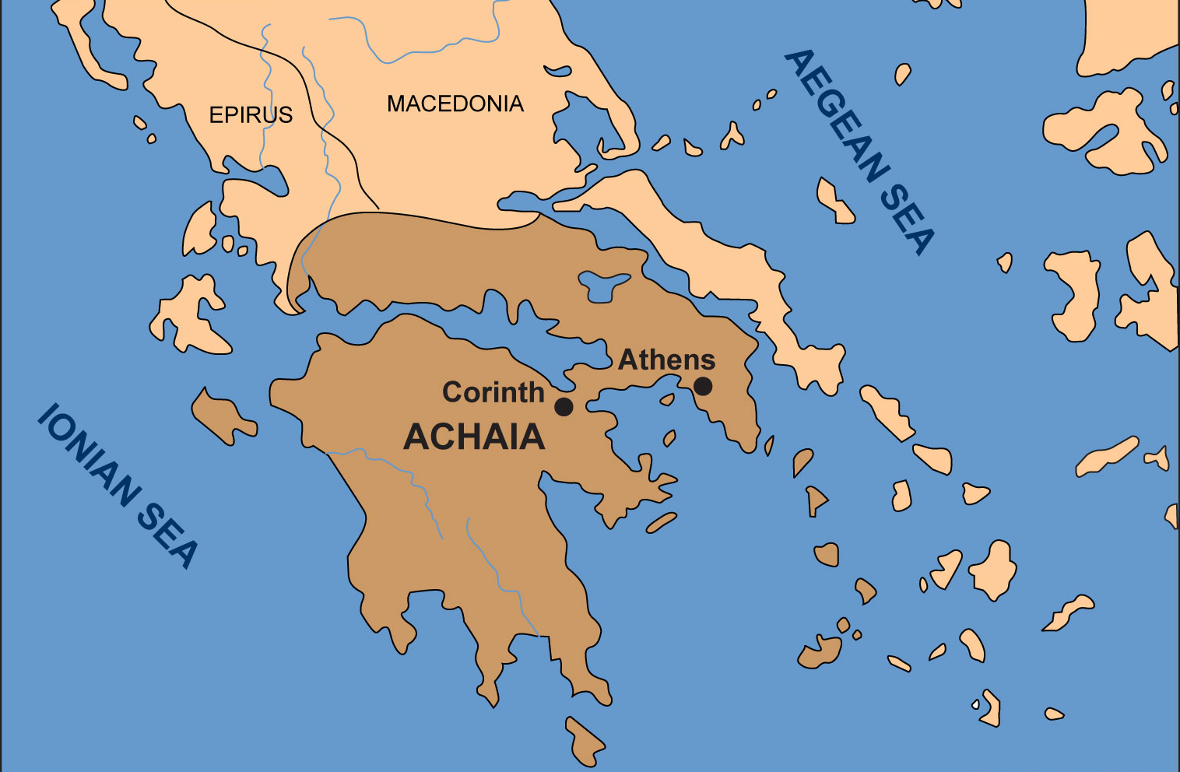
Picture from last week of Athens and Corinth (no blanks)

Slide 9
1 Thessalonians 2:2
“We dared to tell you the Gospel in spite of strong opposition.”

Slide 10
Paul’s Gospel Message
We are created by God
We have rebelled against God
Our sin puts us under God’s wrath
Jesus Christ bore the penalty for our sin
The blood of Jesus turns away God’s wrath
Those who believe in Jesus Christ will be saved
Those who are saved are filled with the Holy Spirit
Those filled with the Spirit have the power to live a life pleasing to God

Slide 11
Many preachers soften the message or change the message

Slide 12
"When He Comes" Part II
He Dares to Tell You the Gospel (vv. 1-2)
His Motive Is Not Self-Serving (v. 3)
His Desire Is Only to Please God (vv. 4-6)
He Is Willing to Bear the Burden (vv. 6-9)
His Personal Life Is Pure (vv. 10-12)
His Ministry Bears Mature Fruit (vv. 13-16)
He Longs to Be With His People (vv. 17-20)

Slide 13
1 Thessalonians 2:3
The appeal we make does not spring from error

Slide 14
2 Peter 2:1-2
“But there were also false prophets among the people, just as there will be false teachers among you. They will secretly introduce destructive heresies, even denying the sovereign Lord who bought them - bringing swift destruction on themselves. Many will follow their shameful ways and will bring the way of truth into disrepute.”

Slide 15
1 Thessalonians 2:3
The appeal we make does not spring from impure motives

Slide 16
Philippians 1:15-16
“It is true that some preach Christ out of envy and rivalry, but others out of goodwill. The latter do so in love, knowing that I am put here for the defense of the gospel. The former preach Christ out of selfish ambition, not sincerely, supposing that they can stir up trouble for me while I am in chains.”

Slide 17
1 Thessalonians 2:3
Nor are we trying to trick you

Slide 18
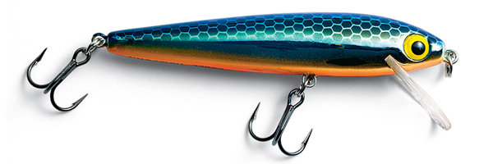
“Trick”
“The Greek for this word was originally used of a lure for catching fish. It came to be used of any sort of cunning used for profit.”

Slide 19
2 Corinthians 2:17
“Unlike so many, we do not peddle the word of God for profit. On the contrary, in Christ we speak before God with sincerity, like men sent from God.”

Slide 20
"When He Comes" Part II
He Dares to Tell You the Gospel (vv. 1-2)
His Motive Is Not Self-Serving (v. 3)
His Desire Is Only to Please God (vv. 4-6)
He Is Willing to Bear the Burden (vv. 6-9)
His Personal Life Is Pure (vv. 10-12)
His Ministry Bears Mature Fruit (vv. 13-16)
He Longs to Be With His People (vv. 17-20)

Slide 21
1 Thessalonians 2:4
“Please God”

Slide 22
Flattery
Greed
Praise

Slide 23
“Praise” =
“Glory”

Slide 24
"When He Comes" Part II
He Dares to Tell You the Gospel (vv. 1-2)
His Motive Is Not Self-Serving (v. 3)
His Desire Is Only to Please God (vv. 4-6)
He Is Willing to Bear the Burden (vv. 6-9)
His Personal Life Is Pure (vv. 10-12)
His Ministry Bears Mature Fruit (vv. 13-16)
He Longs to Be With His People (vv. 17-20)

Slide 25
1 Thessalonians 2:6
“As apostles of Christ we could have been a burden to you.”

Slide 26
1 Corinthians 9:11-15
“If we have sown spiritual seed among you, is it too much if we reap a material harvest from you? If others have this right of support from you, shouldn't we have it all the more? But we did not use this right. On the contrary, we put up with anything rather than hinder the gospel of Christ…

Slide 27
1 Corinthians 9:11-15
“Don't you know that those who work in the temple get their food from the temple, and those who serve at the altar share in what is offered on the altar? In the same way, the Lord has commanded that those who preach the gospel should receive their living from the gospel…

Slide 28
1 Corinthians 9:11-15
“But I have not used any of these rights. And I am not writing this in the hope that you will do such things for me. I would rather die than have anyone deprive me of this boast.”

Slide 29
1 Thessalonians 2:7
“As apostles of Christ we could have been a burden to you, but we were gentle among you, like a mother caring for her little children.”

Slide 30
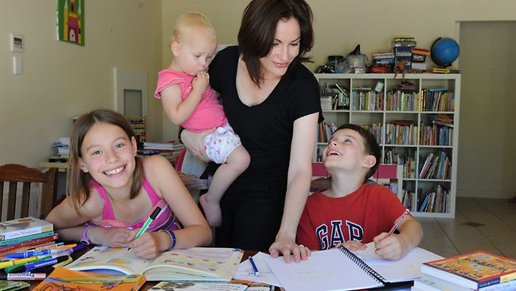

Slide 31
1 Thessalonians 2:8
“We loved you so much that we were delighted to share with you not only the gospel of God but our lives as well, because you had become so dear to us.”

Slide 32
1 Thessalonians 2:9
“Surely you remember, brothers, our toil and hardship; we worked night and day in order not to be a burden to anyone while we preached the gospel of God to you.”

Slide 33
"When He Comes" Part II
He Dares to Tell You the Gospel (vv. 1-2)
His Motive Is Not Self-Serving (v. 3)
His Desire Is Only to Please God (vv. 4-6)
He Is Willing to Bear the Burden (vv. 6-9)
His Personal Life Is Pure (vv. 10-12)
His Ministry Bears Mature Fruit (vv. 13-16)
He Longs to Be With His People (vv. 17-20)

Slide 34
1 Thessalonians 2:10
Holy
Righteous
Blameless

Slide 35
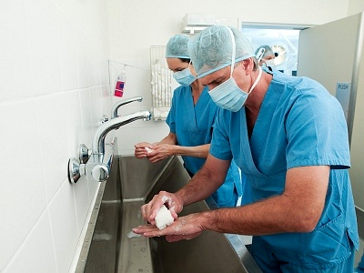
Picture of a surgeon washing his hands intently preparing for surgery

Slide 36
1 Thessalonians 2:11
Father

Slide 37
1 Thessalonians 2:12
Encouraging
Comforting
Urging

Slide 38
"When He Comes" Part II
He Dares to Tell You the Gospel (vv. 1-2)
His Motive Is Not Self-Serving (v. 3)
His Desire Is Only to Please God (vv. 4-6)
He Is Willing to Bear the Burden (vv. 6-9)
His Personal Life Is Pure (vv. 10-12)
His Ministry Bears Mature Fruit (vv. 13-16)
He Longs to Be With His People (vv. 17-20)

Slide 39
They received the Word of God as being not the word of men, but as it, in fact, is—the Word of God.

Slide 40
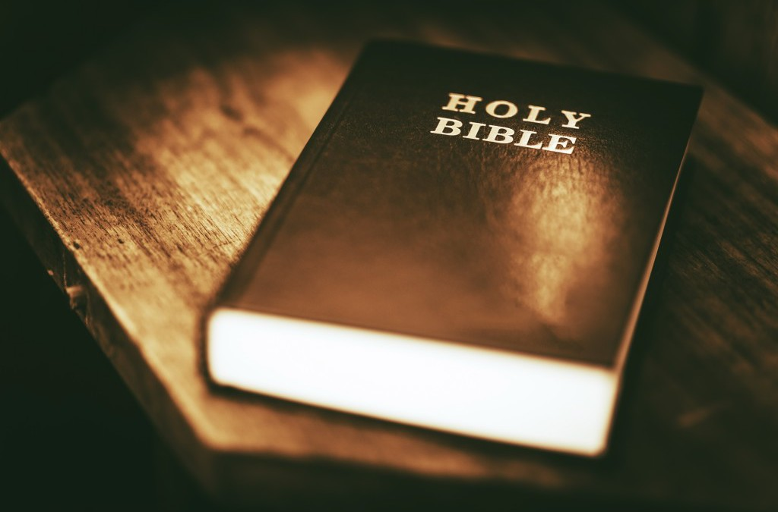
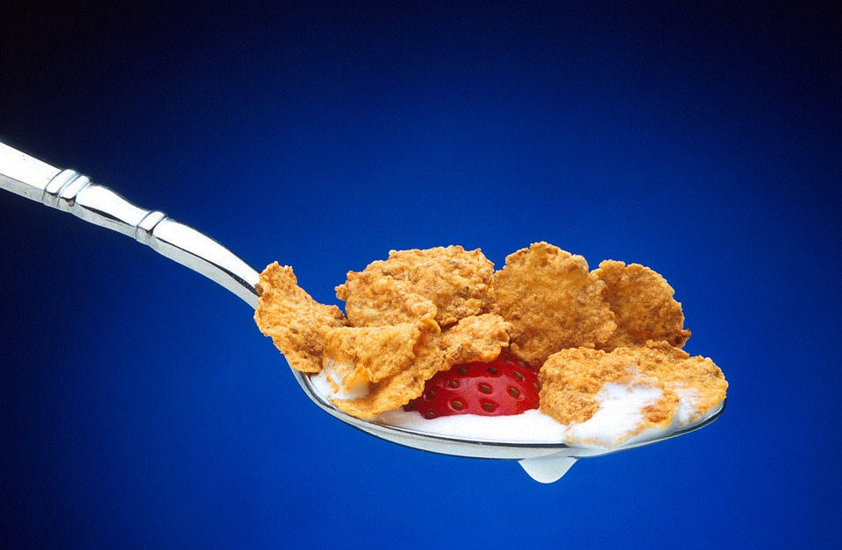
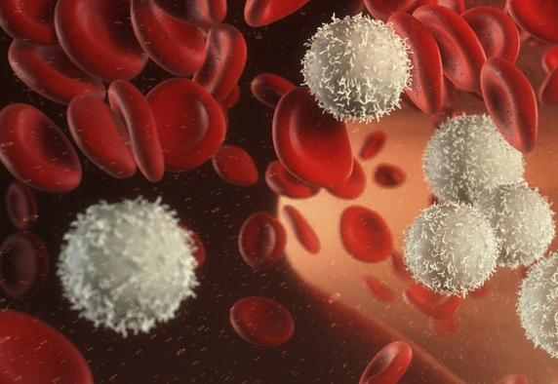
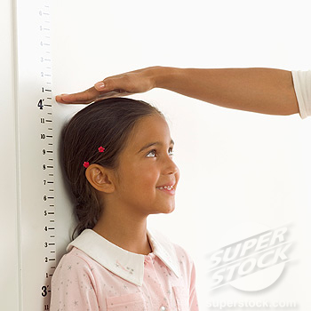
Four Pictures:
The Bible
Nourishing food (maybe on a spoon)
White blood cells
Kid being measured against the wall

Slide 41
1 Thessalonians 2:14
They imitated the churches in Judea

Slide 42
1 Thessalonians 2:15
Suffering

Slide 43
"When He Comes" Part II
He Dares to Tell You the Gospel (vv. 1-2)
His Motive Is Not Self-Serving (v. 3)
His Desire Is Only to Please God (vv. 4-6)
He Is Willing to Bear the Burden (vv. 6-9)
His Personal Life Is Pure (vv. 10-12)
His Ministry Bears Mature Fruit (vv. 13-16)
He Longs to Be With His People (vv. 17-20)

Slide 44
1 Thessalonians 2:17
“But, brothers, when we were torn away from you for a short time (in person, not in thought), out of our intense longing we made every effort to see you.”

Slide 45
1 Thessalonians 2:19
Hope
Joy
Crown

Slide 46
Real Christians need a pastor, and a real pastor longs to be with his people.

Slide 47
“When He Comes”
The First Letter to the Thessalonians
November 27 – Chapter One
“Evidence of True Faith”
December 4 – Chapter Two
“Portrait of a Godly Shepherd”
December 11 – Chapter Three
“The Connection Among Christians”
December 18 – Chapter Four
“Sanctification and Resurrection”
December 25 – Chapter Five
“Ready for the Lord’s Return

Slide 48
WHEN
HE COMES
The First Letter to the Thessalonians

