Slide 1

WHEN
HE COMES
The First Letter to the Thessalonians

Slide 2
Advent
“Joy to the World,
The Lord is Come”
“O Come, O Come Emmanuel”

Slide 3
“When He Comes”
The First Letter to the Thessalonians
November 27 – Chapter One
“Evidence of True Faith”
December 4 – Chapter Two
“Portrait of a Godly Shepherd”
December 11 – Chapter Three
“The Connection Among Christians”
December 18 – Chapter Four
“Sanctification and Resurrection”
December 25 – Chapter Five
“Ready for the Lord’s Return

Slide 4
"When He Comes" Part III
To Be Alone Is Never Desirable (v. 1)
Christians Strengthen One Another (v. 2)
Christians Face Dangerous Trials (vv. 3-4)
Christians Face Dangerous Temptations
(v. 5)
Christian Fellowship Allows Us To Really
Live (vv. 6-8)
Christian Fellowship Gives Joy and
Fulfillment (vv. 9-10)
Christian Fellowship Is a Miracle From God
(vv. 11-13)

Slide 5
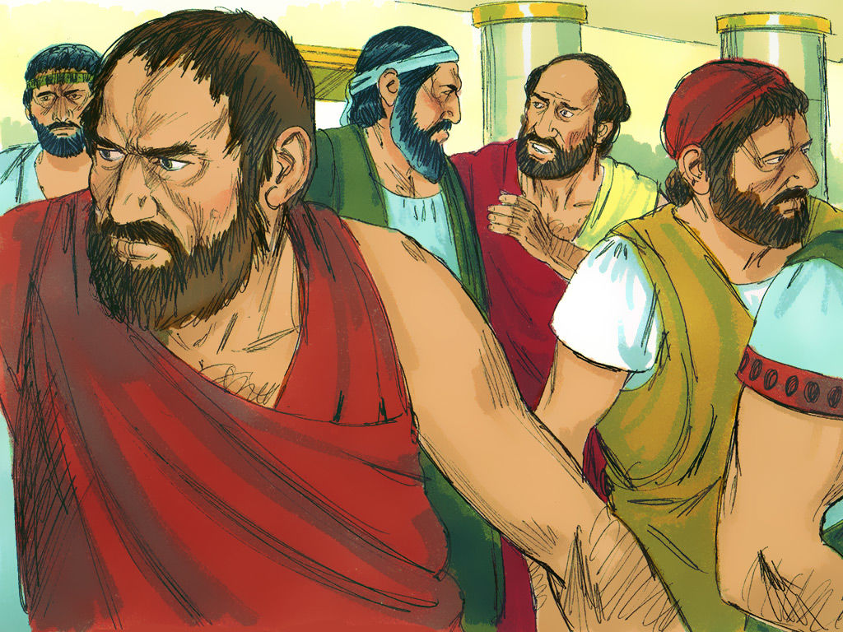
Picture from last week of the rioters

Slide 6
1 Thessalonians 2:17-20
“But, brothers, when we were torn away from you for a short time (in person, not in thought), out of our intense longing we made every effort to see you. For we wanted to come to you—certainly I, Paul, did, again and again—but Satan stopped us…

Slide 7
1 Thessalonians 2:17-20
“For what is our hope, our joy, or the crown in which we will glory in the presence of our Lord Jesus when he comes? Is it not you? Indeed, you are our glory and joy.”

Slide 8
1 Thessalonians 3:1
“So when we could stand it no longer, we thought it best to be left by ourselves in Athens.”

Slide 9
Desirable

Slide 10
Psalm 68:6
“God sets the lonely in families, he leads forth the prisoners with singing;
but the rebellious live in a sun-scorched land.”

Slide 11
The greatest discipline or punishment available is for the church to put someone out of the fellowship.

Slide 12
Alone

Slide 13
"When He Comes" Part III
To Be Alone Is Never Desirable (v. 1)
Christians Strengthen One Another (v. 2)
Christians Face Dangerous Trials (vv. 3-4)
Christians Face Dangerous Temptations
(v. 5)
Christian Fellowship Allows Us To Really
Live (vv. 6-8)
Christian Fellowship Gives Joy and
Fulfillment (vv. 9-10)
Christian Fellowship Is a Miracle From God
(vv. 11-13)

Slide 14
Timothy’s Purpose
in Thessalonica
To strengthen
To encourage

Slide 15
Ephesians 4:16
“From him the whole body, joined and held together by every supporting ligament, grows and builds itself up in love, as each part does its work.”

Slide 16
1 Thessalonians 4:18
“Therefore encourage each other with these words.”

Slide 17
1 Thessalonians 5:11
“Therefore encourage one another and build each other up, just as in fact you are doing.”

Slide 18
1 Thessalonians 5:14
“And we urge you, brothers, warn those who are idle, encourage the timid, help the weak, be patient with everyone.”

Slide 19
"When He Comes" Part III
To Be Alone Is Never Desirable (v. 1)
Christians Strengthen One Another (v. 2)
Christians Face Dangerous Trials (vv. 3-4)
Christians Face Dangerous Temptations
(v. 5)
Christian Fellowship Allows Us To Really
Live (vv. 6-8)
Christian Fellowship Gives Joy and
Fulfillment (vv. 9-10)
Christian Fellowship Is a Miracle From God
(vv. 11-13)

Slide 20
1 Thessalonians 3:3
“so that no one would be unsettled by these trials. You know quite well that we were destined for them.”

Slide 21
1 Thessalonians 3:4
“In fact, when we were with you, we kept telling you that we would be persecuted. And it turned out that way, as you well know.”

Slide 22
2 Timothy 3:12
“In fact, everyone who wants to live a godly life in Christ Jesus will be persecuted…”

Slide 23
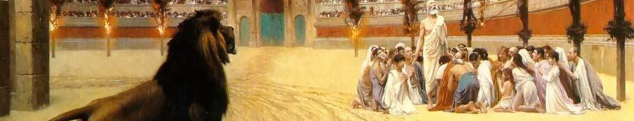
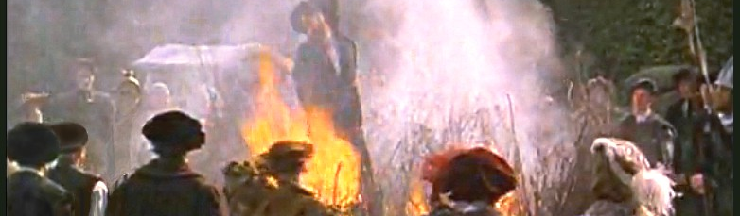
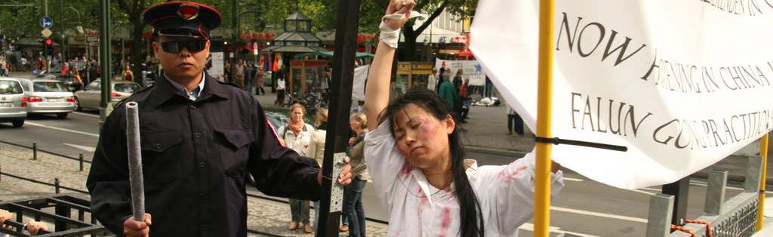
Tri-picture slide
Persecution in the Romans coliseum
Persecution in reformation times (Tyndale being burned at the stake)
Persecution in 20th century (communist persecution)

Slide 24
If you will follow Christ, there will be a cost. But you are not asked to face this alone.

Slide 25
"When He Comes" Part III
To Be Alone Is Never Desirable (v. 1)
Christians Strengthen One Another (v. 2)
Christians Face Dangerous Trials (vv. 3-4)
Christians Face Dangerous Temptations
(v. 5)
Christian Fellowship Allows Us To Really
Live (vv. 6-8)
Christian Fellowship Gives Joy and
Fulfillment (vv. 9-10)
Christian Fellowship Is a Miracle From God
(vv. 11-13)

Slide 26
1 Thessalonians 3:5
“For this reason, when I could stand it no longer, I sent to find out about your faith. I was afraid that in some way the tempter might have tempted you and our efforts might have been useless.”

Slide 27
2 Corinthians 2:11
“in order that Satan might not outwit us. For we are not unaware of his schemes.”

Slide 28
1 Thessalonians 2:18
“Satan stopped us”

Slide 29
Christian Fellowship
Helps us affirm truth
Warns and admonishes against error
Promotes confession and accountability
Adds strength through prayer together
Gives courage because we are not alone

Slide 30
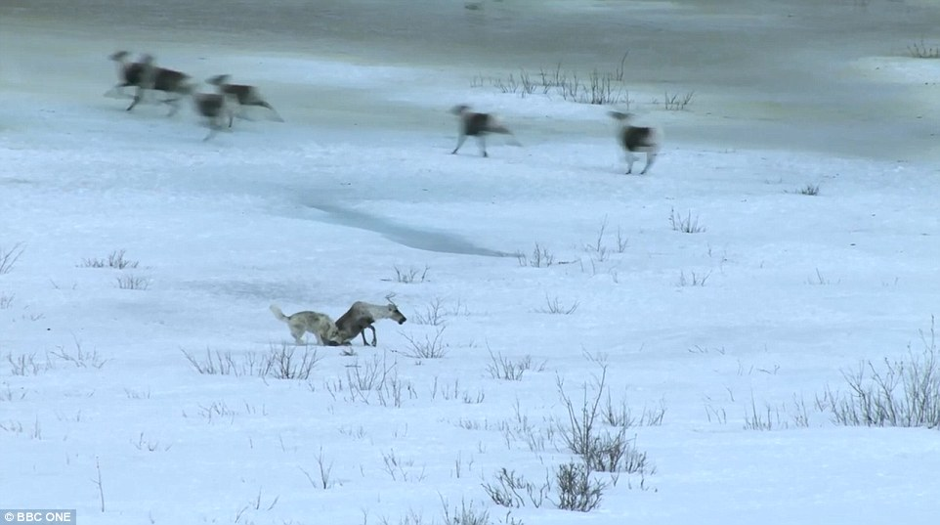
Picture of a Caribou herd (with wolves trailing the caribou herd)

Slide 31
"When He Comes" Part III
To Be Alone Is Never Desirable (v. 1)
Christians Strengthen One Another (v. 2)
Christians Face Dangerous Trials (vv. 3-4)
Christians Face Dangerous Temptations
(v. 5)
Christian Fellowship Allows Us To Really
Live (vv. 6-8)
Christian Fellowship Gives Joy and
Fulfillment (vv. 9-10)
Christian Fellowship Is a Miracle From God
(vv. 11-13)

Slide 32
1 Thessalonians 3:6
“But Timothy has just now come to us from you and has brought good news about your faith and love. He has told us that you always have pleasant memories of us and that you long to see us, just as we also long to see you.”

Slide 33
1 Thessalonians 3:7
“Therefore, brothers, in all our distress and persecution we were encouraged about you because of your faith.”

Slide 34
1 Thessalonians 3:8
“For now we really live, since you are standing firm in the Lord.”

Slide 35
Salvation
Ministry
Fellowship

Slide 36
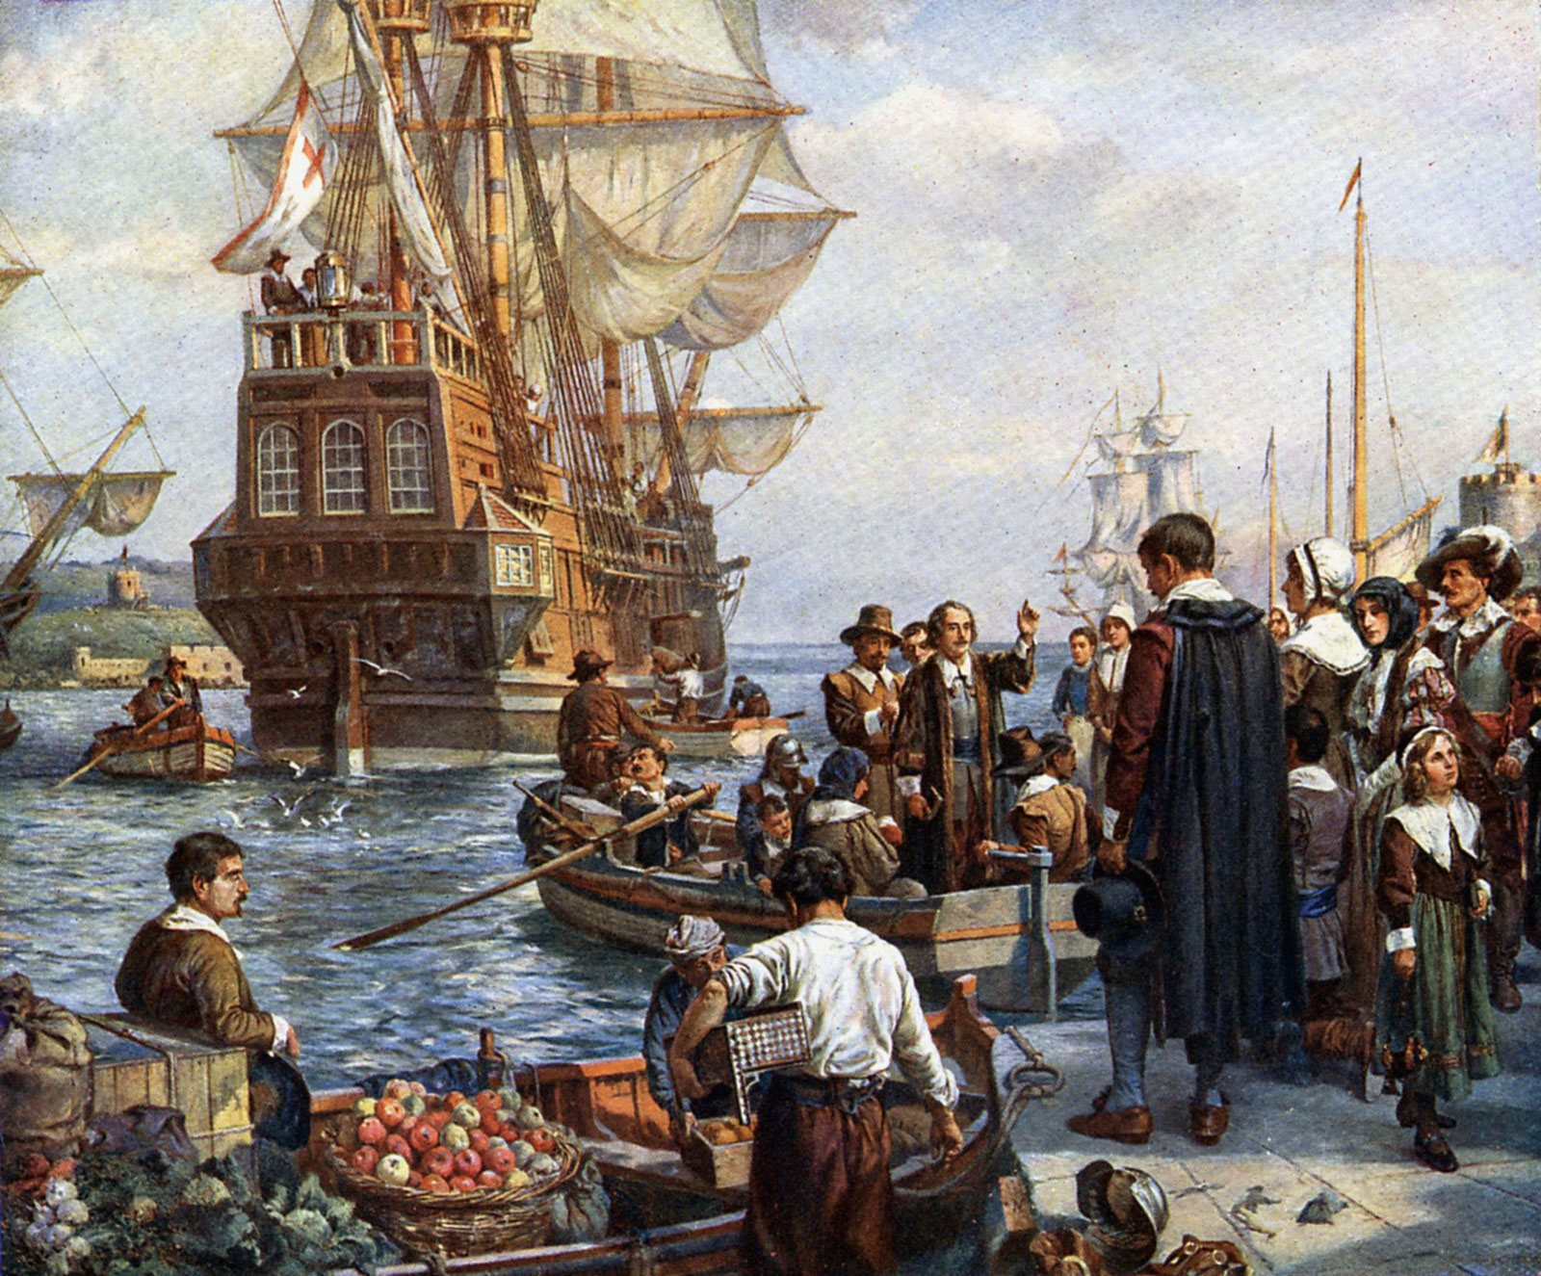
Picture of the pilgrims on the Mayflower

Slide 37
"When He Comes" Part III
To Be Alone Is Never Desirable (v. 1)
Christians Strengthen One Another (v. 2)
Christians Face Dangerous Trials (vv. 3-4)
Christians Face Dangerous Temptations
(v. 5)
Christian Fellowship Allows Us To Really
Live (vv. 6-8)
Christian Fellowship Gives Joy and
Fulfillment (vv. 9-10)
Christian Fellowship Is a Miracle From God
(vv. 11-13)

Slide 38
1 Thessalonians 3:9
“How can we thank God enough for you in return for all the joy we have in the presence of our God because of you?”

Slide 39
Jesus
Others
Yourself

Slide 40
1 Thessalonians 3:10
“Night and day we pray most earnestly that we may see you again and supply what is lacking in your faith.

Slide 41
"When He Comes" Part III
To Be Alone Is Never Desirable (v. 1)
Christians Strengthen One Another (v. 2)
Christians Face Dangerous Trials (vv. 3-4)
Christians Face Dangerous Temptations
(v. 5)
Christian Fellowship Allows Us To Really
Live (vv. 6-8)
Christian Fellowship Gives Joy and
Fulfillment (vv. 9-10)
Christian Fellowship Is a Miracle From God
(vv. 11-13)

Slide 42
1 Thessalonians 3:11
“Now may our God and Father himself and our Lord Jesus clear the way for us to come to you.”

Slide 43
1 Thessalonians 3:12
“May the Lord make your love increase and overflow for each other and for everyone else, just as ours does for you.”

Slide 44
Titus 3:3
“At one time we too were foolish, disobedient, deceived and enslaved by all kinds of passions and pleasures. We lived in malice and envy, being hated and hating one another.”

Slide 45
Miracle

Slide 46
"When He Comes" Part III
To Be Alone Is Never Desirable (v. 1)
Christians Strengthen One Another (v. 2)
Christians Face Dangerous Trials (vv. 3-4)
Christians Face Dangerous Temptations
(v. 5)
Christian Fellowship Allows Us To Really
Live (vv. 6-8)
Christian Fellowship Gives Joy and
Fulfillment (vv. 9-10)
Christian Fellowship Is a Miracle From God
(vv. 11-13)

Slide 47
“When He Comes”
The First Letter to the Thessalonians
November 27 – Chapter One
“Evidence of True Faith”
December 4 – Chapter Two
“Portrait of a Godly Shepherd”
December 11 – Chapter Three
“The Connection Among Christians”
December 18 – Chapter Four
“Sanctification and Resurrection”
December 25 – Chapter Five
“Ready for the Lord’s Return

Slide 48
WHEN
HE COMES
The First Letter to the Thessalonians

