Slide 1

WHEN
HE COMES
The First Letter to the Thessalonians

Slide 2
“When He Comes”
The First Letter to the Thessalonians
November 27 – Chapter One
“Evidence of True Faith”
December 4 – Chapter Two
“Portrait of a Godly Shepherd”
December 11 – Chapter Three
“The Connection Among Christians”
December 18 – Chapter Four
“Sanctification and Resurrection”
December 25 – Chapter Five
“Ready for the Lord’s Return

Slide 3
1 Thessalonians 3:13
“May he strengthen your hearts so that you will be blameless and holy in the presence of our God and Father when our Lord Jesus comes with all his holy ones.”

Slide 4
“When He Comes”
Part IV
Pleasing God (vv. 1-2)
Holy Life (vv. 3-8)
Brotherly Love (vv. 9-12)
Raised to Life (vv. 13-16)
Meet the Lord (vv. 17-18)

Slide 5
Live = Walk

Slide 6

Living to Please Self
Living to Please God

Slide 7
Love

Slide 8

Picture of Bengal Spice tea

Slide 9


Slide 10
1 Thessalonians 4:1
“We ask you and urge you in the Lord Jesus to do this more and more.”

Slide 11
“When He Comes”
Part IV
Pleasing God (vv. 1-2)
Holy Life (vv. 3-8)
Brotherly Love (vv. 9-12)
Raised to Life (vv. 13-16)
Meet the Lord (vv. 17-18)

Slide 12
1 Thessalonians 4:3
“It is God’s will that you should be sanctified.”

Slide 13
1 Thessalonians 4:3
“That you should avoid sexual immorality.”

Slide 14
Ephesians 5:3
“But among you there must not be even a hint of sexual immorality or any kind of impurity.”

Slide 15
1 Thessalonians 4:4
“Each of you should learn to control his own body in a way that is holy and honorable.”

Slide 16
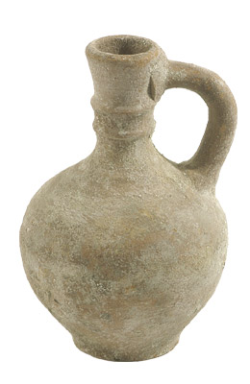
Vessel

Slide 17
1 Thessalonians 4:5
Their decisions are ruled by
“passionate lust.”

Slide 18
1 Thessalonians 4:5
Their mindset is “heathen.”

Slide 19
Romans 1:18
Their relationship with God is that of being under God’s wrath.

Slide 20
1 Thessalonians 4:5
“Who do not know God”

Slide 21
1 Thessalonians 4:6
The offender would “wrong his brother or take advantage of him.”

Slide 22
Wrong His Brother
Draw someone else into sin
Defraud someone’s future spouse and defraud your future spouse
Set an impure example for those you are influencing
Crush the spirit of dear parents and loved ones
Reward evil men who traffic people or people’s images
Allow your family and church to be spiritually affected by your “hidden” sin

Slide 23
1 Thessalonians 4:6
“The Lord will punish men for all such sins, as we have already told you and warned you.”

Slide 24
1 Thessalonians 4:7
“God did not call us to be impure”
God called us to “live a holy life”

Slide 25
1 Thessalonians 4:8
“He who rejects this instruction does not reject man”
He instead rejects “God, who gives you His Holy Spirit”

Slide 26
“When He Comes”
Part IV
Pleasing God (vv. 1-2)
Holy Life (vv. 3-8)
Brotherly Love (vv. 9-12)
Raised to Life (vv. 13-16)
Meet the Lord (vv. 17-18)

Slide 27
Brotherly Love = Philadelphia

Slide 28
John 13:35
“By this all men will know that you are my disciples, if you love one another.”

Slide 29
1 Thessalonians 4:10
“Do so more and more.”

Slide 30
Loving More and More
“Lead a quiet life” (v. 11)
“Mind your own business” (v. 11)
“Work with your hands” (v. 11)
“Do not be dependent on anybody” (v. 12)

Slide 31
“When He Comes”
Part IV
Pleasing God (vv. 1-2)
Holy Life (vv. 3-8)
Brotherly Love (vv. 9-12)
Raised to Life (vv. 13-16)
Meet the Lord (vv. 17-18)

Slide 32
Are you living this life
ready to meet the Lord?

Slide 33
1 Thessalonians 4:13
“We do not want you to be ignorant about those who fall asleep.”

Slide 34
We Believe
(vv. 14-15)
Jesus died
Jesus rose again
Those who die in Christ will
be like Jesus in rising

Slide 35
1 Thessalonians 4:16
“The dead in Christ will rise first.”

Slide 36
Resurrection

Slide 37
2 Corinthians 5:8
“Absent from the body but present with the Lord.”

Slide 38
- - - - - - - - - - - - - - - - - - -

Slide 39
“When He Comes”
Part IV
Pleasing God (vv. 1-2)
Holy Life (vv. 3-8)
Brotherly Love (vv. 9-12)
Raised to Life (vv. 13-16)
Meet the Lord (vv. 17-18)

Slide 40
1 Thessalonians 4:17
“After that, we who are still alive and are left will be caught up together with them in the clouds to meet the Lord in the air. And so we will be with the Lord forever.”

Slide 41
Raptured

Slide 42
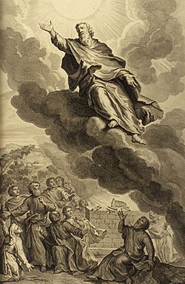
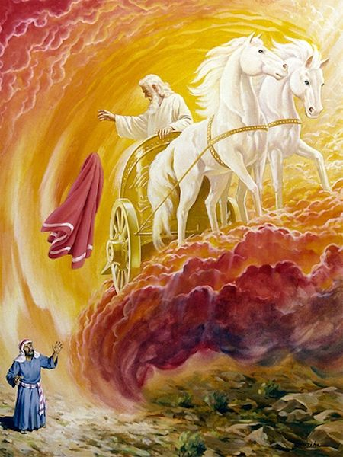
Enoch
Elijah

Slide 43
Every Christians Will One Day Experience Either Resurrection or Rapture
1 Thessalonians 4:17
“Caught up together with them in the clouds to meet the Lord in the air. And so we will be with the Lord forever.”

Slide 44
1 Thessalonians 4:18
“Therefore encourage each other with these words.”

Slide 45
Titus 2:13
“while we wait for the blessed hope—the glorious appearing of our great God and Savior, Jesus Christ…”

Slide 46
Revelation 22:20
“He who testifies to these things says, ‘Yes, I am coming soon.’
Amen. Come, Lord Jesus.”

Slide 47
Are you ready for Jesus to come?

Slide 48
“When He Comes”
The First Letter to the Thessalonians
November 27 – Chapter One
“Evidence of True Faith”
December 4 – Chapter Two
“Portrait of a Godly Shepherd”
December 11 – Chapter Three
“The Connection Among Christians”
December 18 – Chapter Four
“Sanctification and Resurrection”
December 25 – Chapter Five
“Ready for the Lord’s Return

Slide 49
WHEN
HE COMES
The First Letter to the Thessalonians

