Slide 1
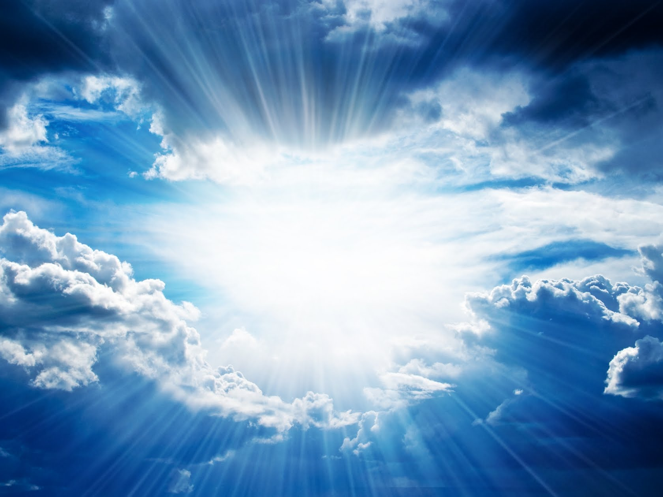
WHEN
HE COMES
The First Letter to the Thessalonians

Slide 2
“When He Comes”
The First Letter to the Thessalonians
November 27 – Chapter One
“Evidence of True Faith”
December 4 – Chapter Two
“Portrait of a Godly Shepherd”
December 11 – Chapter Three
“The Connection Among Christians”
December 18 – Chapter Four
“Sanctification and Resurrection”
December 25 – Chapter Five
“Ready for the Lord’s Return

Slide 3
“When He Comes”
Part V
Thief In the Night (vv. 1-3)
Sons of the Day (vv. 4-7)
Appointed to Salvation (vv. 8-11)
Living In Peace (vv. 12-15)
Always, In All Circumstances
(vv. 23-28)
Prayer and Requests (vv. 23-28)

Slide 4
1 Thessalonians 4:16
“For the Lord himself will come down from heaven, with a loud command, with the voice of the archangel and with the trumpet call of God, and the dead in Christ will rise first.”

Slide 5
1 Thessalonians 4:17
“After that, we who are still alive and are left will be caught up together with them in the clouds to meet the Lord in the air. And so we will be with the Lord forever.

Slide 6
1 Thessalonians 5:2
“For you know very well that the day of the Lord will come like a thief in the night.”

Slide 7
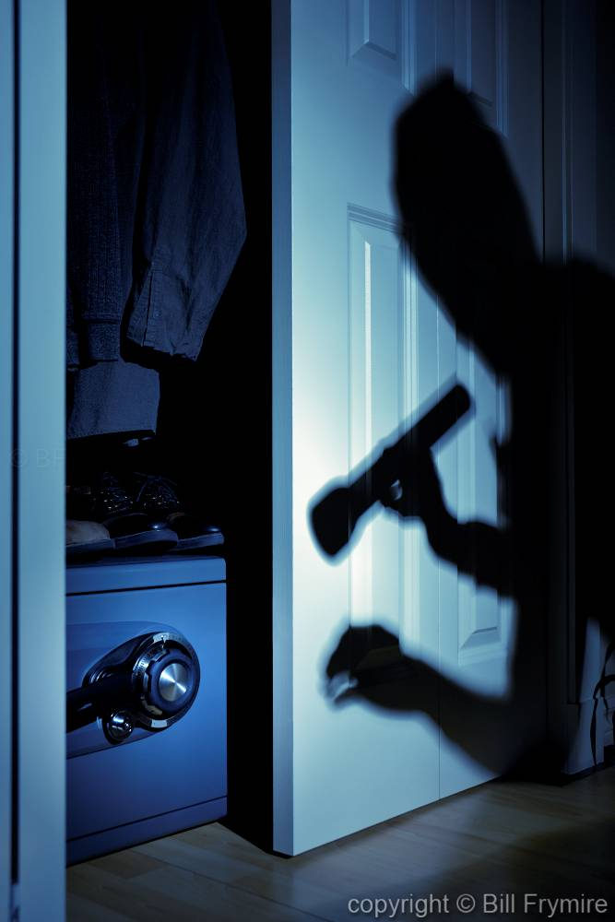

Slide 8
2 Peter 3:10
“But the day of the Lord will come like a thief. The heavens will disappear with a roar; the elements will be destroyed by fire, and the earth and everything in it will be laid bare.”

Slide 9
2 Peter 3:11
“Since everything will be destroyed in this way, what kind of people ought you to be? You ought to live holy and godly lives…”

Slide 10
1 Thessalonians 5:3
“While people are saying, ‘Peace and safety,’ destruction will come on them suddenly, as labor pains on a pregnant woman, and they will not escape.”

Slide 11
“When He Comes”
Part V
Thief In the Night (vv. 1-3)
Sons of the Day (vv. 4-7)
Appointed to Salvation (vv. 8-11)
Living In Peace (vv. 12-15)
Always, In All Circumstances
(vv. 23-28)
Prayer and Requests (vv. 23-28)

Slide 12
1 Thessalonians 5:5
You are all sons of the light and sons of the day. We do not belong to the night or to the darkness.

Slide 13
Light, Day

Slide 14
1 Thessalonians 5:6
“So then, let us not be like others, who are asleep, but let us be alert and self-controlled.”

Slide 15
Not Ready

Slide 16
1 Thessalonians 5:6
“So then, let us not be like others, who are asleep, but let us be alert and self-controlled.”

Slide 17
1 Thessalonians 5:7
“For those who sleep, sleep at night, and those who get drunk, get drunk at night.”

Slide 18
“When He Comes”
Part V
Thief In the Night (vv. 1-3)
Sons of the Day (vv. 4-7)
Appointed to Salvation (vv. 8-11)
Living In Peace (vv. 12-15)
Always, In All Circumstances
(vv. 23-28)
Prayer and Requests (vv. 23-28)

Slide 19
But since we belong to the day we have a calling, an obligation, to live a life ready for the day of the Lord.

Slide 20
1 Thessalonians 5:8
“But since we belong to the day, let us be self-controlled, putting on faith and love as a breastplate, and the hope of salvation as a helmet.

Slide 21
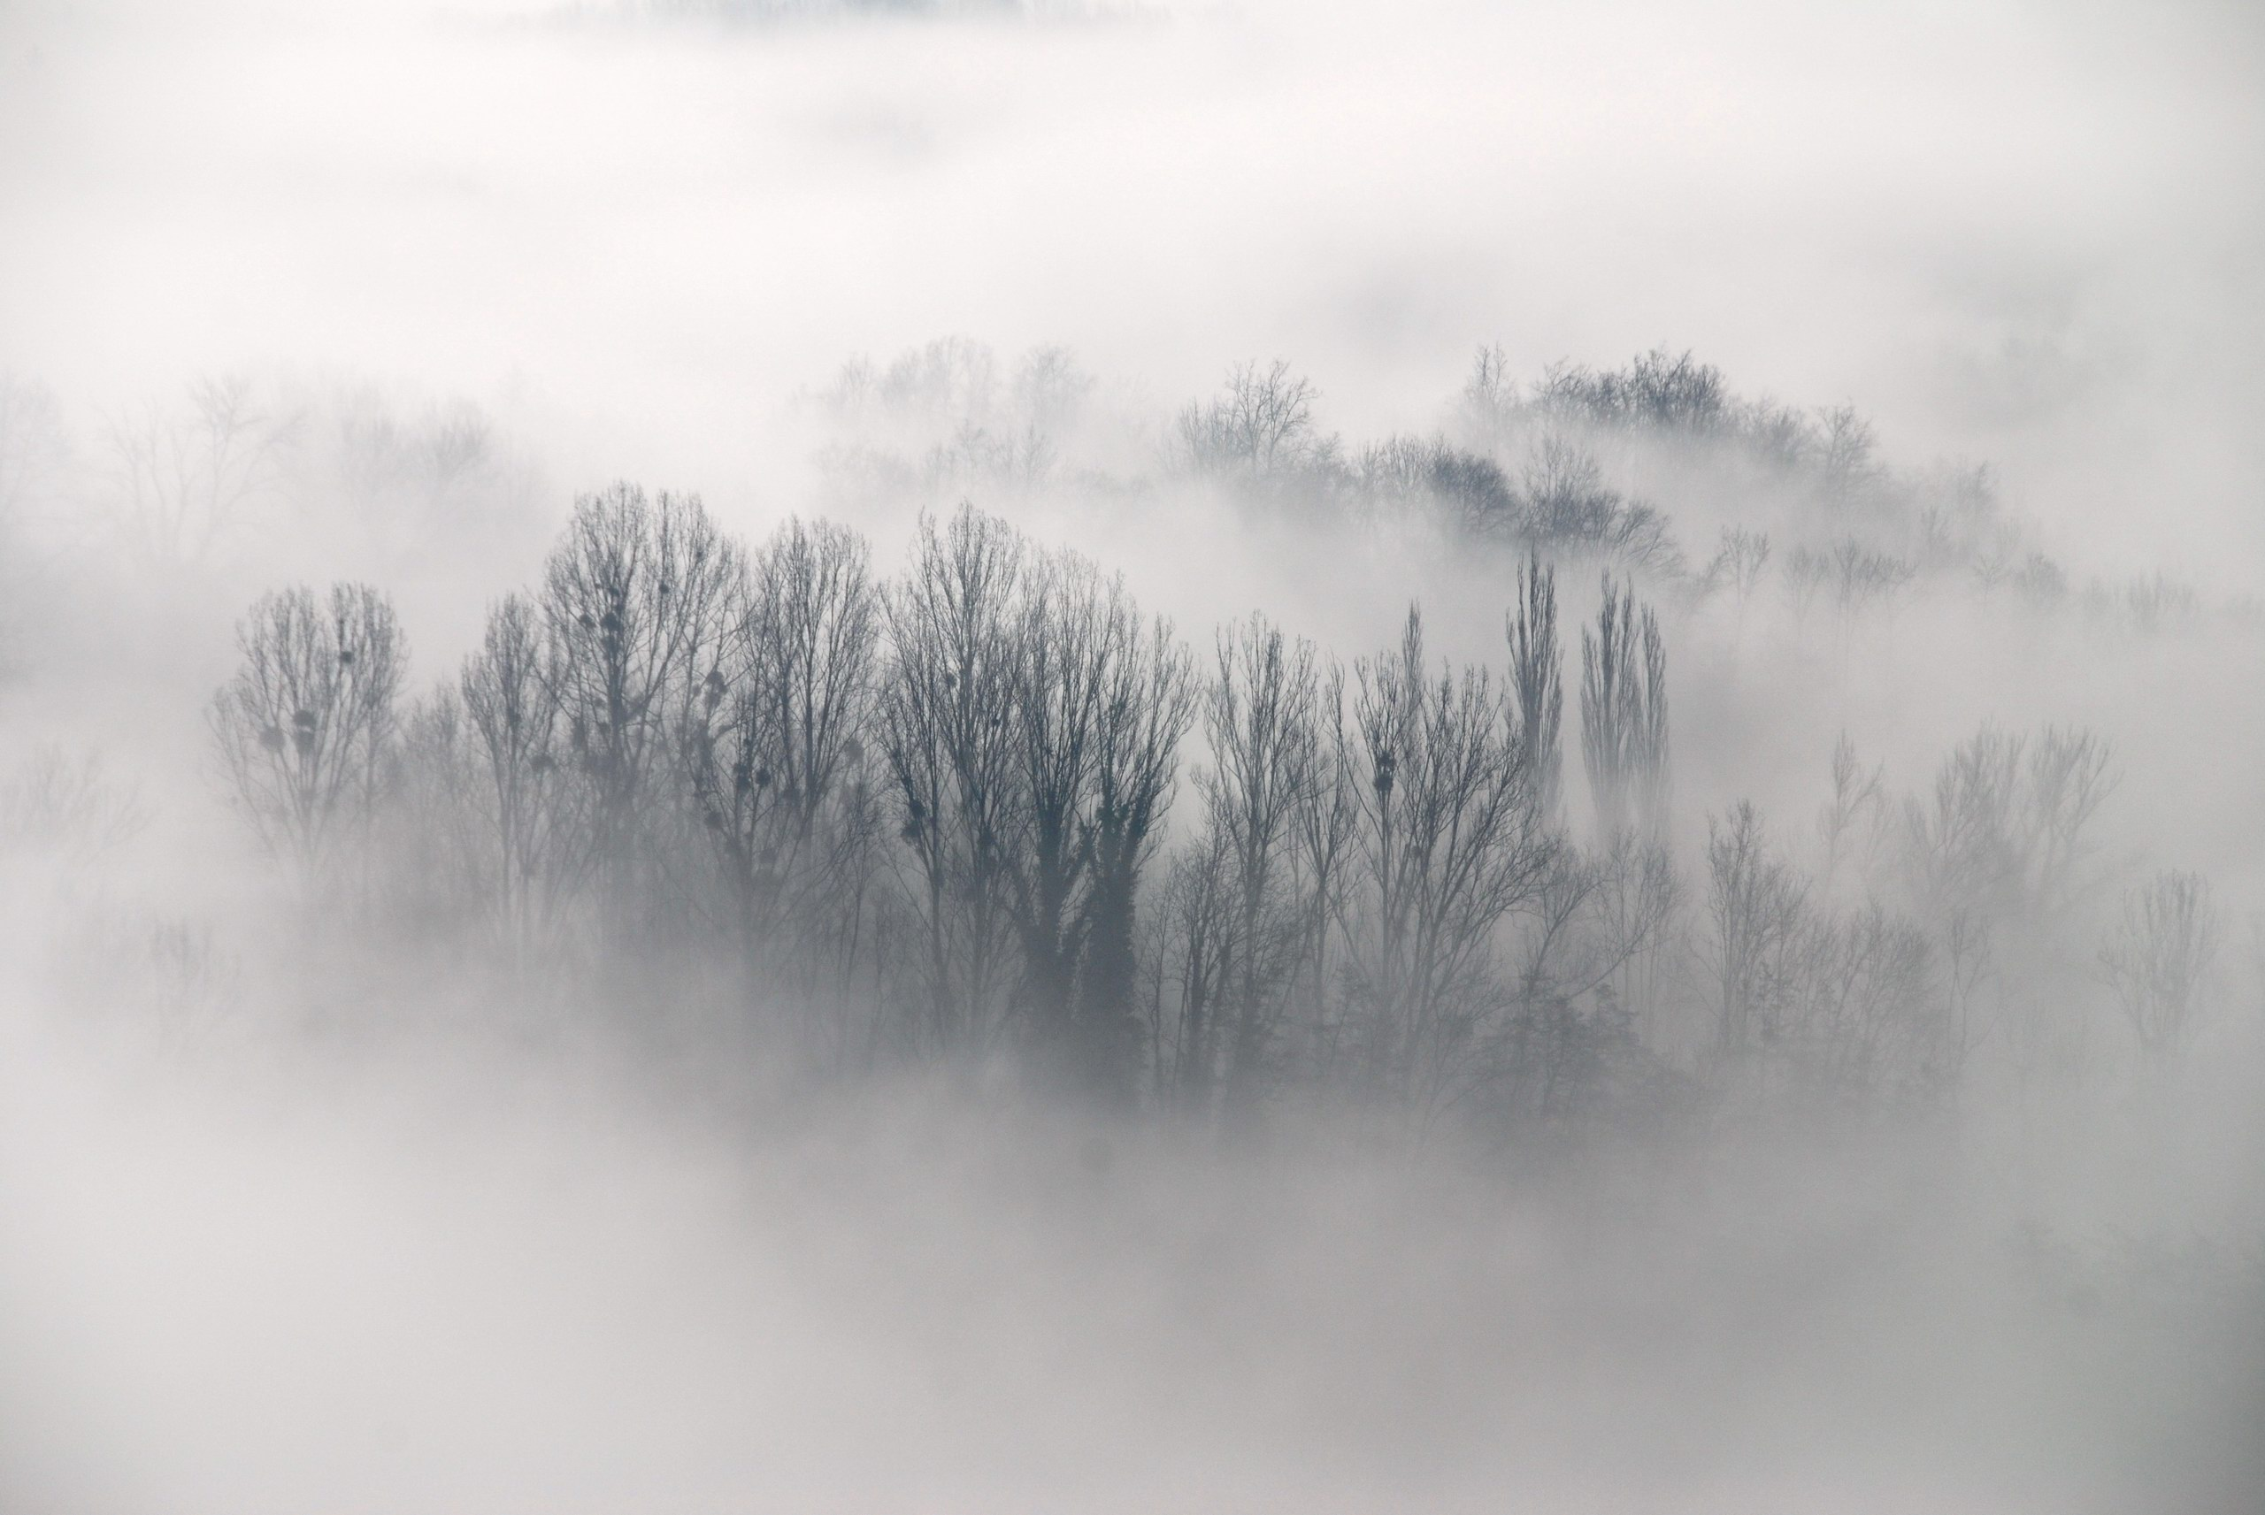
Picture of fog

Slide 22
1 Thessalonians 5:9
“For God did not appoint us to suffer wrath but to receive salvation through our Lord Jesus Christ.”

Slide 23
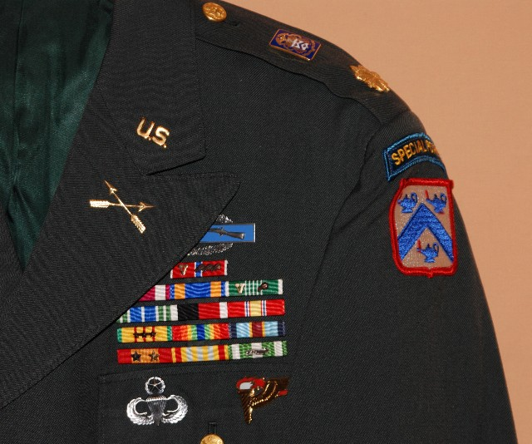
Picture of a military uniform on a hanger being taken to put on

Slide 24
Therefore, we may live with Him now while we await His return, and live with Him then when He returns.

Slide 25
1 Thessalonians 5:11
“Therefore encourage one another and build each other up, just as in fact you are doing.”

Slide 26
“When He Comes”
Part V
Thief In the Night (vv. 1-3)
Sons of the Day (vv. 4-7)
Appointed to Salvation (vv. 8-11)
Living In Peace (vv. 12-15)
Always, In All Circumstances
(vv. 23-28)
Prayer and Requests (vv. 23-28)

Slide 27
Live in peace with each other

Slide 28
1 Thessalonians 5:12
“Now we ask you, brothers, to respect those who work hard among you, who are over you in the Lord and who admonish you.”

Slide 29
Hebrews 13:7
“Obey your leaders and submit to their authority. They keep watch over you as men who must give an account. Obey them so that their work will be a joy, not a burden, for that would be of no advantage to you.”

Slide 30
Hebrews 13:8
“Pray for us.”

Slide 31
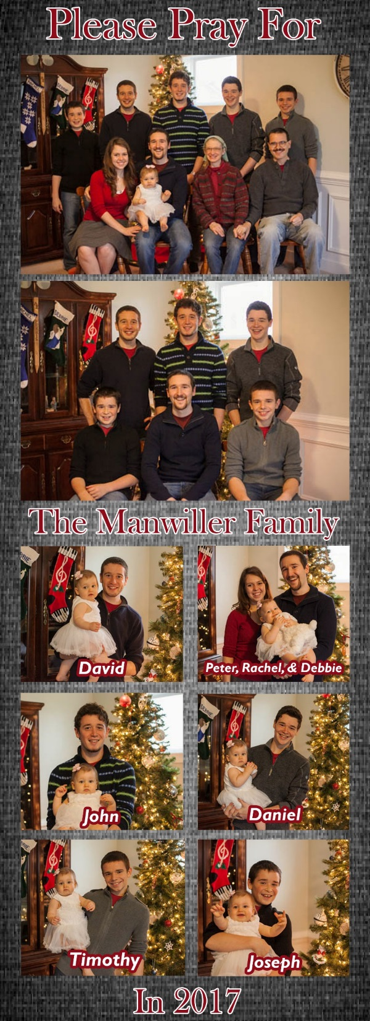

Slide 32
1 Thessalonians 5:13
“Hold them in the highest regard in love because of their work. Live in peace with each other.”

Slide 33
1 Thessalonians 5:14-15
“And we urge you, brothers, warn those who are idle, encourage the timid, help the weak, be patient with everyone. Make sure that nobody pays back wrong for wrong, but always try to be kind to each other and to everyone else.”

Slide 34
“When He Comes”
Part V
Thief In the Night (vv. 1-3)
Sons of the Day (vv. 4-7)
Appointed to Salvation (vv. 8-11)
Living In Peace (vv. 12-15)
Always, In All Circumstances
(vv. 23-28)
Prayer and Requests (vv. 23-28)

Slide 35
1 Thessalonians 5:16-18
“Be joyful always; pray continually; give thanks in all circumstances, for this is God's will for you in Christ Jesus.”

Slide 36
1 Thessalonians 5:19-22
“Do not put out the Spirit's fire; do not treat prophecies with contempt. Test everything. Hold on to the good. Avoid every kind of evil.”

Slide 37


Slide 38
“When He Comes”
Part V
Thief In the Night (vv. 1-3)
Sons of the Day (vv. 4-7)
Appointed to Salvation (vv. 8-11)
Living In Peace (vv. 12-15)
Always, In All Circumstances
(vv. 23-28)
Prayer and Requests (vv. 23-28)

Slide 39
1 Thessalonians 5:23
“May God himself, the God of peace, sanctify you through and through. May your whole spirit, soul and body be kept blameless at the coming of our Lord Jesus Christ.”

Slide 40
1 Thessalonians 5:24
“The one who calls you is faithful and he will do it.”

Slide 41
1 Thessalonians 5:25
“Brothers, pray for us.”

Slide 42


Slide 43
1 Thessalonians 5:26
“Greet all the brothers with a holy kiss.”

Slide 44
1 Thessalonians 5:27
“I charge you before the Lord to have this letter read to all the brothers.”

Slide 45
Are you ready for Christmas?

Slide 46
Are you ready for Jesus’ Return?

Slide 47
WHEN
HE COMES
The First Letter to the Thessalonians

