Slide 1
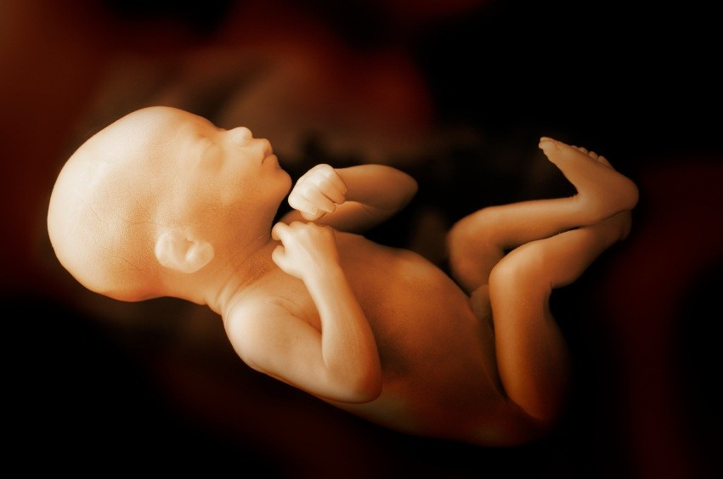
2017 Sanctity of
Human Life

Slide 2
Sanctity of Human Life
What Is God's Plan For the
Unborn?
Who Would Seek to Harm the
Unborn?
Who Will Stand to Help the
Unborn?

Slide 3
Psalm 139:13-16
“For you created my inmost being; you knit me together in my mother's womb. I praise you because I am fearfully and wonderfully made; your works are wonderful, I know that full well…

Slide 4
Psalm 139:13-16
“My frame was not hidden from you when I was made in the secret place. When I was woven together in the depths of the earth, your eyes saw my unformed body. All the days ordained for me were written in your book before one of them came to be.”

Slide 5
Psalm 139:13
“Inmost Being” = Spiritual Aspect
“Knit me together” = Physical Aspect

Slide 6
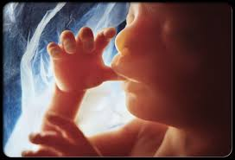
Psalm 139:14
“Wonderfully made”

Slide 7
Psalm 139:15-16
“All the days ordained to me”

Slide 8
Jeremiah 1:5
“Before I formed you in the womb I knew you, before you were born I set you apart; I appointed you as a prophet to the nations.”

Slide 9
Luke 1:13-15
“But the angel said to him: ‘Do not be afraid, Zechariah; your prayer has been heard. Your wife Elizabeth will bear you a son, and you are to give him the name John…

Slide 10
Luke 1:13-15
“‘He will be a joy and delight to you, and many will rejoice because of his birth, for he will be great in the sight of the Lord. He is never to take wine or other fermented drink, and he will be filled with the Holy Spirit even from birth.’”

Slide 11
Luke 1:39-45
“At that time Mary got ready and hurried to a town in the hill country of Judea, where she entered Zechariah's home and greeted Elizabeth. When Elizabeth heard Mary's greeting, the baby leaped in her womb, and Elizabeth was filled with the Holy Spirit…

Slide 12
Luke 1:39-45
“In a loud voice she exclaimed: ‘Blessed are you among women, and blessed is the child you will bear! But why am I so favored, that the mother of my Lord should come to me? As soon as the sound of your greeting reached my ears, the baby in my womb leaped for joy. Blessed is she who has believed that what the Lord has said to her will be accomplished!’”

Slide 13
Fetus

Slide 14
Sanctity of Human Life
What Is God's Plan For the
Unborn?
Who Would Seek to Harm the
Unborn?
Who Will Stand to Help the
Unborn?

Slide 15
Leviticus 20:1-5
“The LORD said to Moses, ‘Say to the Israelites: “Any Israelite or any alien living in Israel who gives any of his children to Molech must be put to death. The people of the community are to stone him. I will set my face against that man and I will cut him off from his people;…

Slide 16
Leviticus 20:1-5
“For by giving his children to Molech, he has defiled my sanctuary and profaned my holy name. If the people of the community close their eyes when that man gives one of his children to Molech and they fail to put him to death, I will set my face against that man and his family and will cut off from their people both him and all who follow him in prostituting themselves to Molech.”’”

Slide 17
Over 97% of abortions are performed for reason of convenience

Slide 18
Margaret Sanger
“Human weeds”
“More children from the fit, less from the unfit”
“The most merciful thing that a large family does to one of its infant members is to kill it”

Slide 19

Picture of a planned parenthood facility

Slide 20
How many babies since 1973?
60 Million

Slide 21
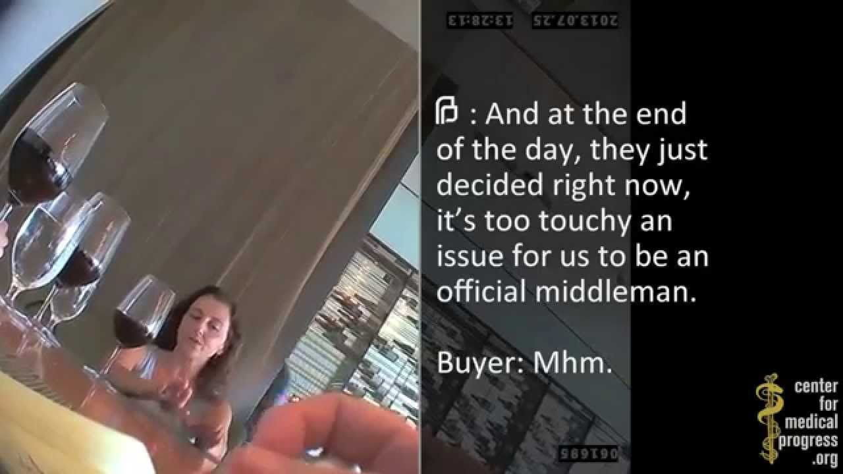
Screenshot of something from Medical Progress of an abortion provider sipping wine and discussing the sale of body parts

Slide 22
Numbers 35:33
“Do not pollute the land where you are. Bloodshed pollutes the land, and atonement cannot be made for the land on which blood has been shed, except by the blood of the one who shed it.”

Slide 23
Sanctity of Human Life
What Is God's Plan For the
Unborn?
Who Would Seek to Harm the
Unborn?
Who Will Stand to Help the
Unborn?

Slide 24
Proverbs 24:11
“Rescue those being led away to death; hold back those staggering toward slaughter.”

Slide 25

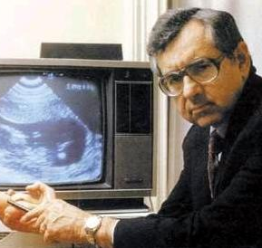
Bernard Nathanson

Slide 26

Abby Johnson

Slide 27
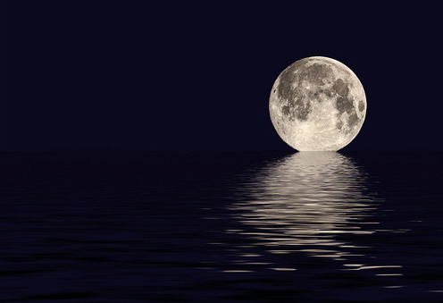
“There just wasn’t room”

Slide 28
Proverbs 24:11
“Rescue those being led away to death; hold back those staggering toward slaughter.”

Slide 29
Sanctity of Human Life
What Is God's Plan For the
Unborn?
Who Would Seek to Harm the
Unborn?
Who Will Stand to Help the
Unborn?

Slide 30
2017 Sanctity of
Human Life

