Slide 1

Fur Rondy Slide

Slide 2
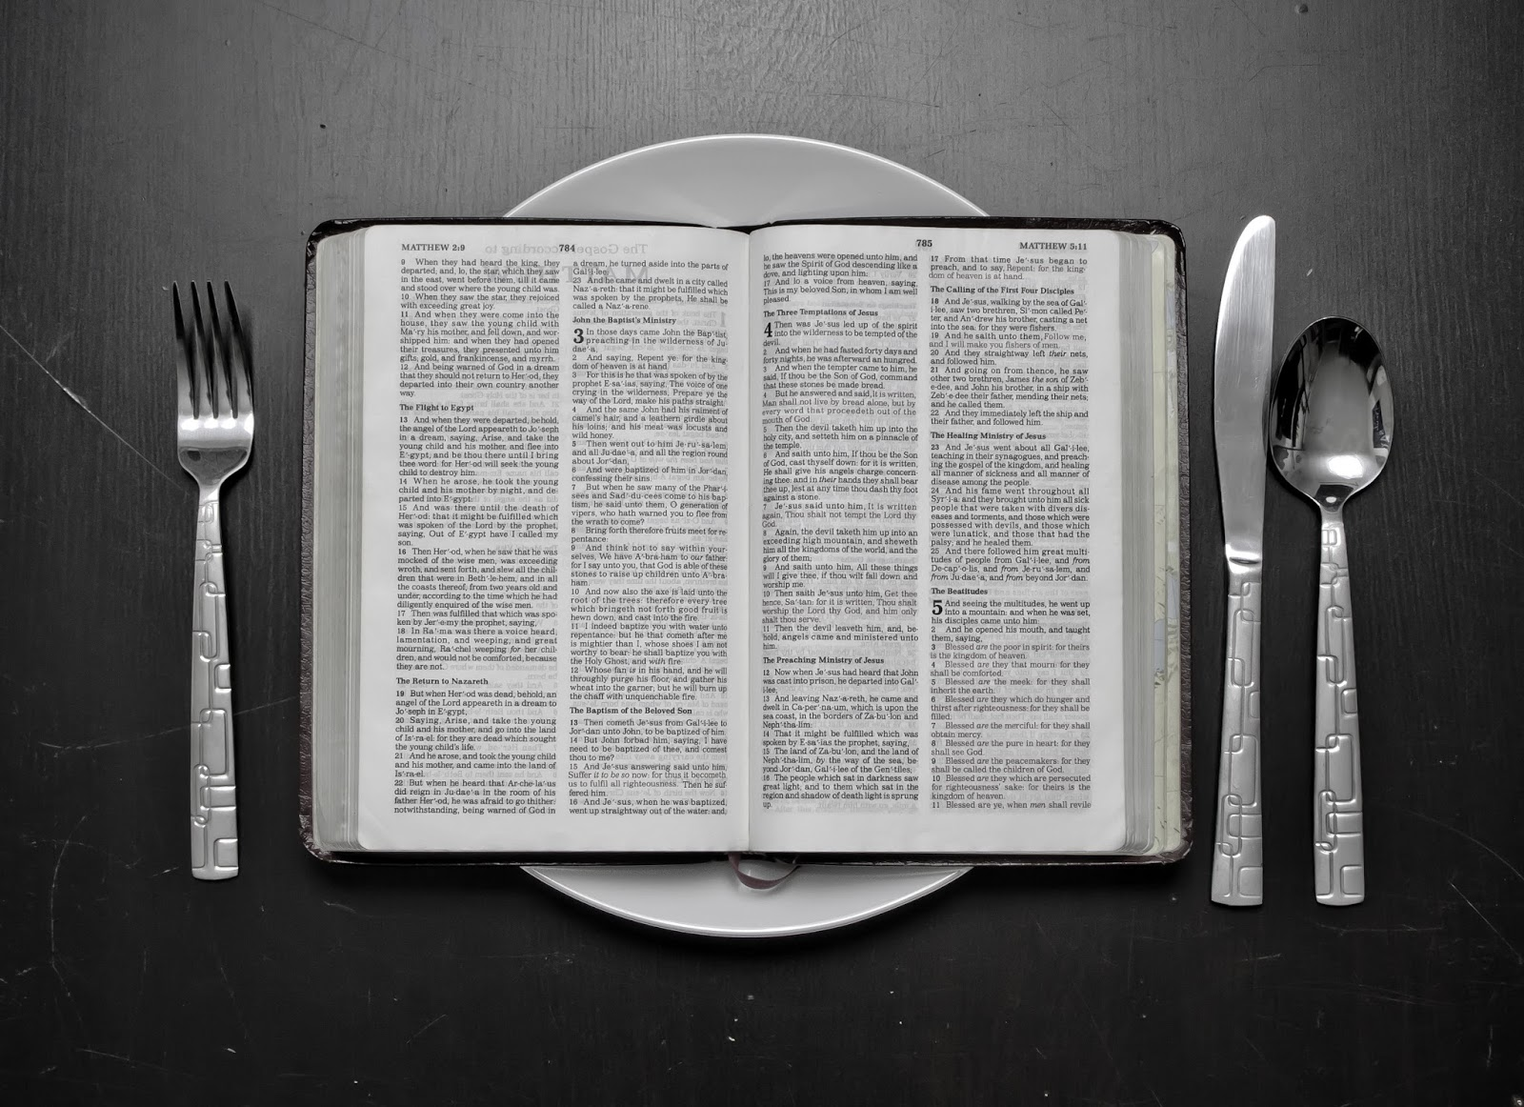
Hungry for God’s Word

Slide 3
Hungry For God’s Word
Our Need For God's Word
Our Intake of God's Word

Slide 4
God Reveals Himself
Through creation
Through Scripture
Through Jesus Christ

Slide 5
Psalm 19:1
“The heavens declare the glory of God; the skies proclaim the work of his hands.”

Slide 6
Psalm 19:2-4
“Day after day they pour forth speech; night after night they display knowledge. There is no speech or language where their voice is not heard. Their voice goes out into all the earth, their words to the ends of the world.”

Slide 7
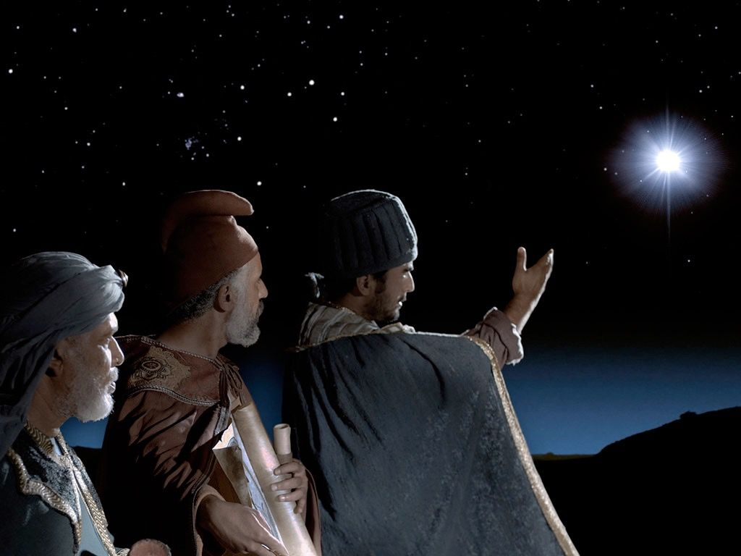

Slide 8
Psalm 19:4-6
“Their voice goes out into all the earth, their words to the ends of the world. In the heavens he has pitched a tent for the sun, which is like a bridegroom coming forth from his pavilion, like a champion rejoicing to run his course. It rises at one end of the heavens and makes its circuit to the other; nothing is hidden from its heat.

Slide 9
Romans 1:18-20
“The wrath of God is being revealed from heaven against all the godlessness and wickedness of men who suppress the truth by their wickedness, since what may be known about God is plain to them, because God has made it plain to them…

Slide 10
Romans 1:18-20
“For since the creation of the world God's invisible qualities—his eternal power and divine nature—have been clearly seen, being understood from what has been made, so that men are without excuse.”

Slide 11
God Reveals Himself
Through creation
Through Scripture
Through Jesus Christ

Slide 12
Psalm 19:7-9
“The law of the LORD is perfect,
reviving the soul. The statutes of the LORD are trustworthy, making wise the simple. The precepts of the LORD are right, giving joy to the heart…

Slide 13
Psalm 19:7-9
“The commands of the LORD are radiant, giving light to the eyes. The fear of the LORD is pure, enduring forever. The ordinances of the LORD are sure and altogether righteous.”

Slide 14
General Revelation
Special Revelation

Slide 15
Psalm 19:7-9
Law = God’s revealed will
Testimony = God’s truth, as
declared by Himself
Precepts = God’s precision and
authority
Fear = Reverence for God’s authority
Ordinances = God’s judgments about
human situations

Slide 16
God Reveals Himself
Through creation
Through Scripture
Through Jesus Christ

Slide 17
Hebrews 1:1-3
“In the past God spoke to our forefathers through the prophets at many times and in various ways, but in these last days he has spoken to us by his Son, whom he appointed heir of all things, and through whom he made the universe…

Slide 18
Hebrews 1:1-3
“The Son is the radiance of God's glory and the exact representation of his being, sustaining all things by his powerful word. After he had provided purification for sins, he sat down at the right hand of the Majesty in heaven.”

Slide 19
Psalm 19:10-11
“They are more precious than gold, than much pure gold; they are sweeter than honey, than honey from the comb. By them is your servant warned; in keeping them there is great reward.”

Slide 20
From Revelation to Relationship

Slide 21
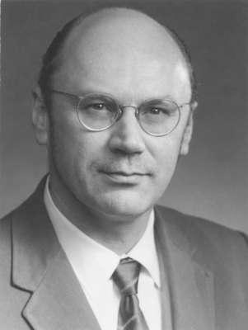
Dr. Boris Dotsenko

Slide 22
Hungry For God’s Word
Our Need For God's Word
Our Intake of God's Word

Slide 23
Our Intake of God’s Word
Hearing God’s Word
Reading God’s Word
Studying God’s Word
Memorizing God’s Word
Meditating on God’s Word

Slide 24
1 Timothy 4:13
“Until I come, devote yourself to the public reading of Scripture, to preaching and to teaching.”

Slide 25
Our Intake of God’s Word
Hearing God’s Word
Reading God’s Word
Studying God’s Word
Memorizing God’s Word
Meditating on God’s Word

Slide 26
Questions to Ask When You Read
What does it say? (Observation)
What does it mean? (Interpretation)
What is God teaching me? (Application)

Slide 27
Humility

Slide 28
Our Intake of God’s Word
Hearing God’s Word
Reading God’s Word
Studying God’s Word
Memorizing God’s Word
Meditating on God’s Word

Slide 29
Joshua 1:8
“Do not let this Book of the Law depart from your mouth; meditate on it day and night, so that you may be careful to do everything written in it. Then you will be prosperous and successful.”

Slide 30
Psalm 1:1-3
“Blessed is the man who does not walk in the counsel of the wicked or stand in the way of sinners or sit in the seat of mockers. But his delight is in the law of the LORD, and on his law he meditates day and night…

Slide 31
Psalm 1:1-3
“He is like a tree planted by streams of water, which yields its fruit in season and whose leaf does not wither. Whatever he does prospers.”

Slide 32
Psalm 19:14
“May the words of my mouth and the meditation of my heart be pleasing in your sight, O LORD, my Rock and my Redeemer.”

Slide 33
John 11:25
“Jesus said to her, "I am the resurrection and the life. He who believes in me will live, even though he dies;”

Slide 34
Our Intake of God’s Word
Hearing God’s Word
Reading God’s Word
Studying God’s Word
Memorizing God’s Word
Meditating on God’s Word

Slide 35
Hungry for God’s Word

