Slide 1
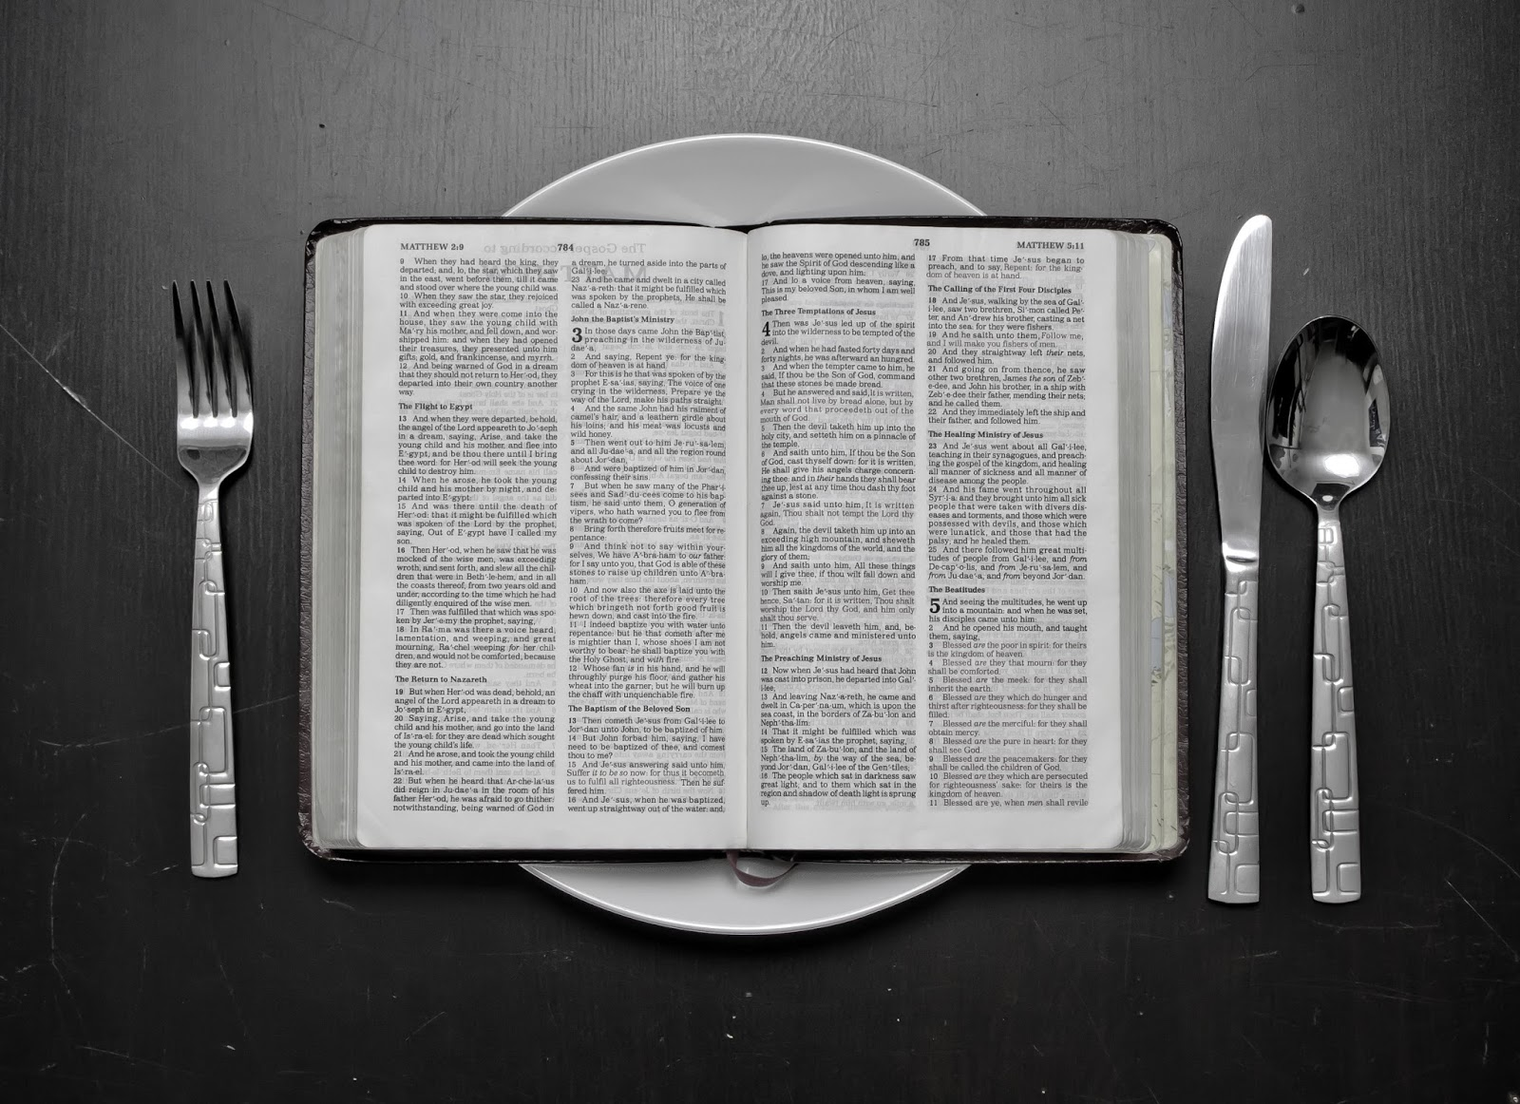
Hungry for God’s Word

Slide 2
Hungry For God’s Word
Grasping God's Word
Interpreting God's Word
Prioritizing God's Word

Slide 3
Deuteronomy 6:6-9
“These commandments that I give you today are to be upon your hearts. Impress them on your children. Talk about them when you sit at home and when you walk along the road, when you lie down and when you get up. Tie them as symbols on your hands and bind them on your foreheads. Write them on the doorframes of your houses and on your gates.”

Slide 4
Perspicuity of Scripture

Slide 5
Spiritual Confusion
Spiritual Deafness

Slide 6
John 14:25-26
“All this I have spoken while still with you. But the Counselor, the Holy Spirit, whom the Father will send in my name, will teach you all things and will remind you of everything I have said to you.”

Slide 7
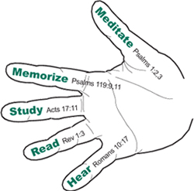

Slide 8


Slide 9
Hungry For God’s Word
Grasping God's Word
Interpreting God's Word
Prioritizing God's Word

Slide 10
Interpreting God’s Word
The meaning of a text is determined by the meaning of the words.

Slide 11
Interpreting God’s Word
The meaning of the words must be determined in light of the larger context.

Slide 12
Interpreting God’s Word
The meaning of any text must be consistent with the whole of Scripture.

Slide 13
Interpreting God’s Word
The meaning of the text is not to be determined by your personal feelings or expectations.

Slide 14
Interpreting God’s Word
The text should usually be interpreted according to the plain meaning available to the original audience

Slide 15
Interpreting God’s Word
Historical narratives are to be interpreted by the didactic.

Slide 16
Interpreting God’s Word
The incomplete (Old Testament) is to be interpreted by the complete (New Testament).

Slide 17
Hungry For God’s Word
Grasping God's Word
Interpreting God's Word
Prioritizing God's Word

Slide 18
Psalm 119:105-112
“Your word is a lamp to my feet and a light for my path. I have taken an oath and confirmed it, that I will follow your righteous laws. I have suffered much; preserve my life, O LORD, according to your word..

Slide 19
Psalm 119:105-112
“Accept, O LORD , the willing praise of my mouth, and teach me your laws. Though I constantly take my life in my hands, I will not forget your law. The wicked have set a snare for me, but I have not strayed from your precepts…

Slide 20
Psalm 119:105-112
“Your statutes are my heritage forever; they are the joy of my heart. My heart is set on keeping your decrees to the very end.”

Slide 21
I Asked the Lord That I May Grow
I asked the Lord that I might grow
In faith and love and ev’ry grace,
Might more of His salvation know,
And seek more earnestly His face.

Slide 22
I Asked the Lord That I May Grow
‘Twas He who taught me thus to pray,
And He, I trust, has answered prayer,
But it has been in such a way
As almost drove me to despair.

Slide 23
I Asked the Lord That I May Grow
I hoped that in some favored hour
At once He’d answer my request
And, by His love’s constraining pow’r,
Subdue my sins and give me rest.

Slide 24
I Asked the Lord That I May Grow
Instead of this, He made me feel
The hidden evils of my heart
And let the angry pow’rs of hell
Assault my soul in ev’ry part.

Slide 25
I Asked the Lord That I May Grow
Yea, more with His own hand He seemed
Intent to aggravate my woe,
Crossed all the fair designs I schemed,
Humbled my heart and laid me low.

Slide 26
I Asked the Lord That I May Grow
“Lord, why is this,” I trembling cried;
“Wilt Thou pursue Thy worm to death?”
“‘Tis in this way,” the Lord replied,
“I answer prayer for grace and faith.”

Slide 27
I Asked the Lord That I May Grow
“These inward trials I employ
From self and pride to set thee free
And break thy schemes of earthly joy
That thou may’st find thy all in Me.”

Slide 28
Hungry for God’s Word

Slide 29

Fur Rondy Slide

